Slide 1
Regrets and Kidneys
Andrew Mao, Stacy Wong

Slide 2
Intro to Online Stochastic Optimization
Data revealed over time
Distribution of future events is known
Under time constraints
Limits amount of sampling/simulation
Solve these problems with two black boxes:
Conditional sampling distribution
Offline optimization algorithm
Why is the problem nontrivial?
Notes:
[stacy] talk about difficulty of the packet scheduling problem
Contrast with offline problems where data is known a priori

Slide 3
Modeling with a Special Class of MDPs
Consider exogenous Markov Decision Process (X-MDP) as a way to model certain problems
Exogenous uncertainty - random events are independent of our actions
We can sample arbitrarily far into the future, then optimize actions with respect to samples
Traditional methods to solve MDPs: search algorithm, Bellman equations
The following problems and algorithms all apply to this case
Notes:
[andrew] show the decision tree require in this kind of MDP vs. the tree expansion required for value or policy iteration solutions

Slide 4
Motivation: Packet Scheduling Problem
Schedule unknown sequence of jobs
Goal: Maximize total value of jobs processed
Assumptions:
Set of jobs Jobs with different arrival times
Schedule horizon H = [H_{min}, H_{max}] to schedule jobs
Each job j has weight w(j)
j requires a single time unit to process
Only one job per time unit
j must be scheduled in time window [a(j), a(j) + d]
d is the same for all j
Schedule is a function σ: H --> Jobs
Notes:
[stacy]

Slide 5
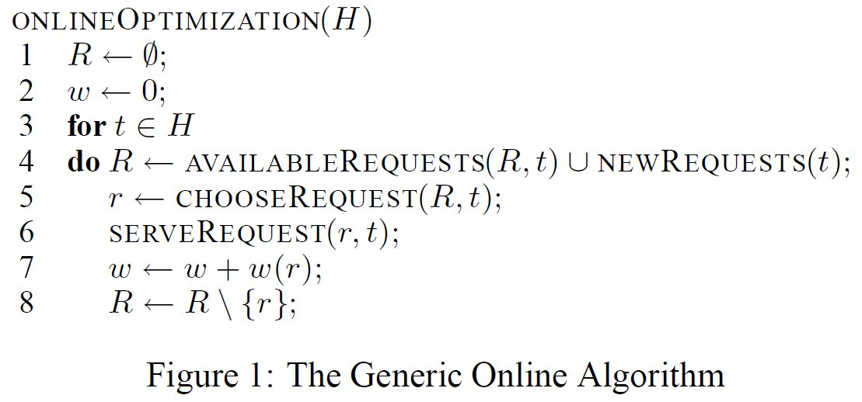
Generic Online Optimization Algorithm
Notes:
[stacy]

Slide 6
Oblivious Algorithms
Greedy Algorithm
Local Optimal Algorithm
Notes:
[stacy]

Slide 7
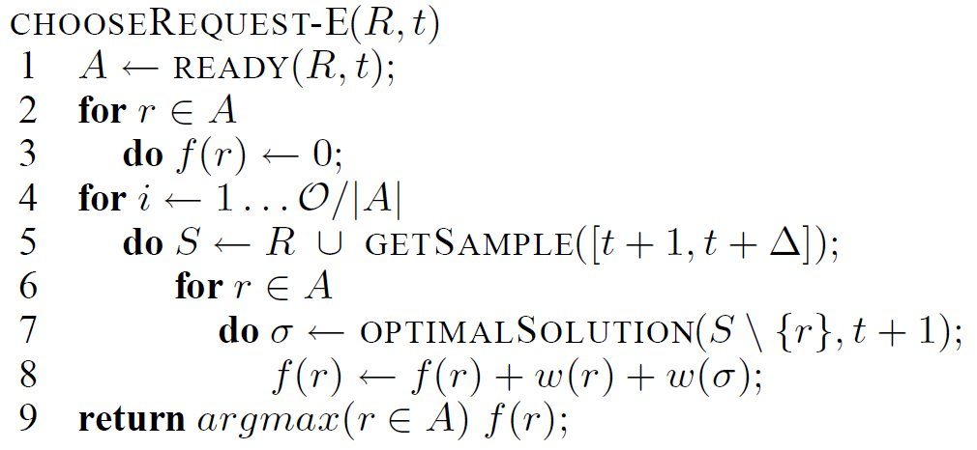
Stochastic: Expectation Algorithm
Bad complexity - requires O = m|A| for only m samples, small if O fixed and |A| large
Estimates are very optimistic: overestimate bias in score function (but for every action!)
Maximizes expected value of serving this request
Notes:
[stacy]

Slide 8
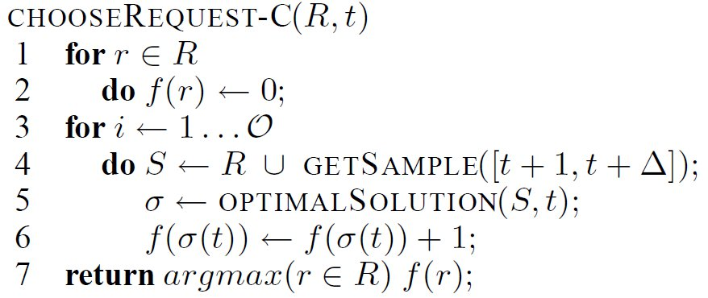
Stochastic: Consensus Algorithm
This is an "elitist" algorithm; the mode wins!
Expected value (and distribution of values) ignored
C+E_{k} algorithm
Quantitative consensus (QC) algorithm
Notes:
[stacy] can probably skip bottom two algos

Slide 9
A New Approach: Regret
"Regret" -- what would happen if we chose a sub-optimal solution now?
Assume we can cheaply estimate the regret of a request r at time t
Combines stochastic optimization for each sample, with the ability to do an estimate for each action
We use RegretUB() for an upper bound on regret
Notes:
[andrew] Discuss regret. The difference between the optimal solution and the best solution serving some other request now.

Slide 10
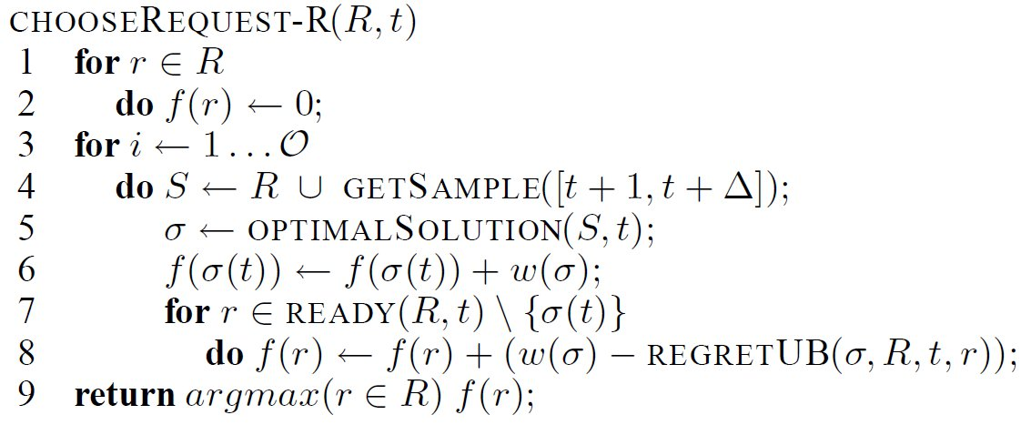
Stochastic: Regret Algorithm
Perform offline optimization once per sample
Notes:
[andrew] insert regret function

Slide 11
Results
Notes:
[stacy]

Slide 12
Discussion of Stochastic Algorithms
How many times do we use the offline optimization and how efficiently (i.e. |A| times per sample, or once per sample)
Normalized for algorithms described here
Regret algorithm depends on the cheapness and accuracy of the RegretUB estimator
E is R with an exact regret
QC is R with worst case regret (fastest)
Notes:
[andrew] Skip vehicle routing, MSA algorithm, DoD
Question: Before we move onto kidneys, now that we have a background in online stochastic optimization problems, what do people think of using this to model the kidney matching problem?

Slide 13
Kidney Problem Formulation
Patients, donors arrive and expire (literally)
Blood and tissue types can be modeled as a (conditional) distribution
Randomness not dependent on actions we can use scenario sampling as described earlier
Problem Formulation:
Directed graph, vertices are patient-donor pairs, compatibilities are edges.
Each edge (u -> v) is assigned a weight which describes "goodness" of donor kidney in v for patient in vertex u
L is limit for cycle length, usually 3
Maximization problem
Notes:
[stacy]

Slide 14
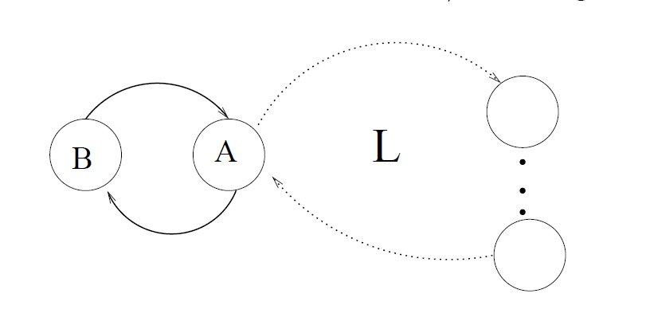
The problem with prior-free approach
Proposition 1
No deterministic prior-free algorithm can do better than L/2
Proposition 2
No randomized prior-free algorithm can do better than (2L-2)/L - approximately 2
only 75% of possible lives saved in this case.
Notes:
[andrew] chalk it - example for prop1 is easy, no real example for prop2

Slide 15
Adapting Regrets Algorithm to Kidneys
The action space for kidneys is to enumerate the set of all vertex disjoint cycles processed at time t
Exponential in the number of cycles; not tractable
So, we split sets of cycles into individual cycles for optimization, then use another optimization to recombine cycles
Do we lose correlated information?
Assume number of cycles is still manageable if length limited
Notes:
[stacy] Question: how did people feel about breaking down into individual cycles.
Perhaps smaller cycles will get a higher score because they appear in more optimal solutions.

Slide 16
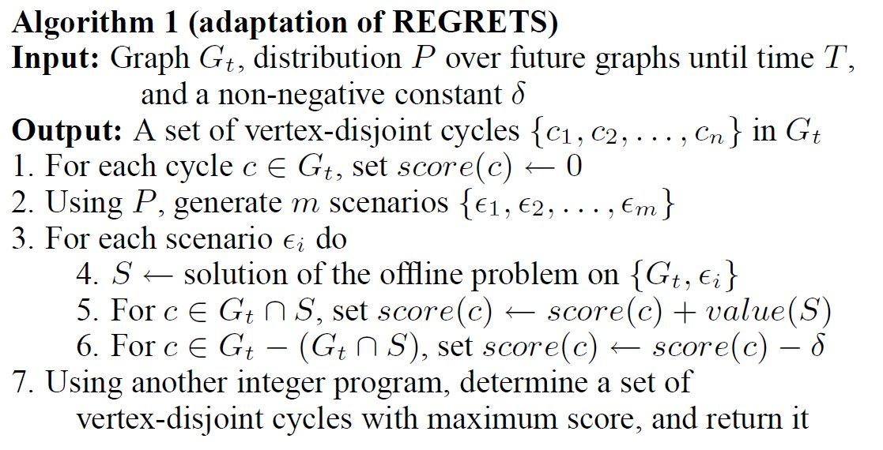
A1 “Direct adaptation of regrets”
Is this a correct implementation of regrets?
Somewhat resembles the QC algorithm
Notes:
[andrew] Note the numeraire of cycles being the value of possible remaining cycles in the graph
Why is there a delta?

Slide 17
Algorithm 1 is not optimal!
Notes:
[stacy] Walk through example of why A1 is not optimal on the board

Slide 18
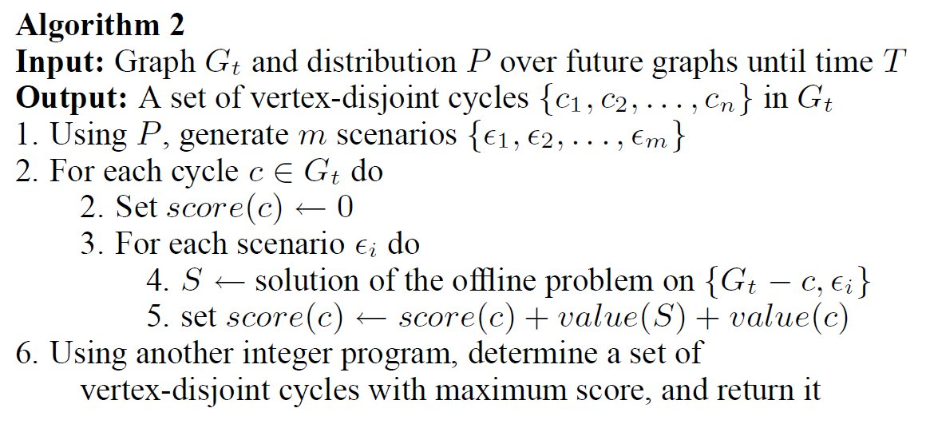
A2 Optimizing regrets for each action
What is the complexity of this algorithm?
Are the number of offline optimizations normalized?
According to simulation, the number of scenarios used to test algorithms 1 and 2 are the same.
Notes:
[andrew] complexity A1 is linear in the number of scenarios, A2 is linear in the number of scenarios*cycles

Slide 19
Do Regrets make you GAG?
Local Anticipatory Gap – the minimum expected loss in some given state by taking a certain action
Intuitive explanation - LAG is low if there is an action that is close to optimal for most of the future scenarios
Global Anticipatory Gap – A (maximal) sum of the local anticipatory gaps
A smaller GAG is correlated to better performance of regrets-based algorithms
Notes:
[andrew] David's diagram of GAG

Slide 20
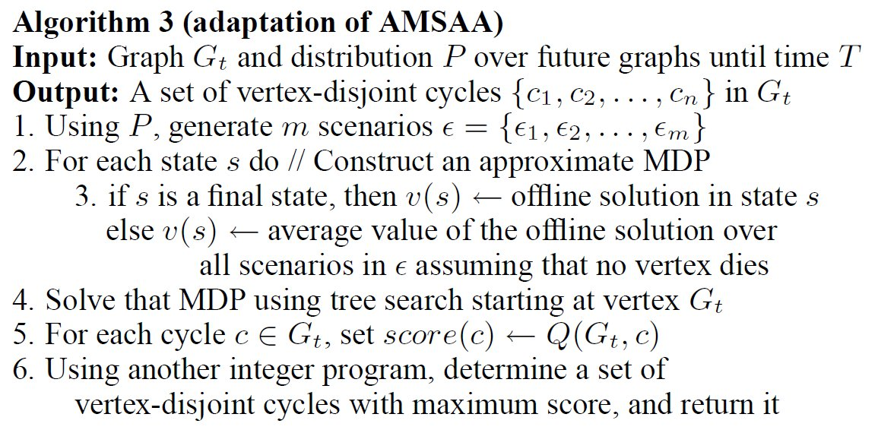
A3 AMSAA algorithm using MDPs
Converts exogenous MDP to normal MDP, solving with heuristic search algorithm
Bad scaling properties. Could not be used for simulated data
Notes:
[Stacy] – describe by talking

Slide 21
Characterization of results
Both of the following increase complexity:
Look-ahead period is the number of time steps into the future
No. of samples determines how many random paths are considered
With kidney data, batch size is the time step over which actions are taken
Things to note:
Algorithm 1 was ‘questionably’ regrets
Algorithms 1 and 2 ran with the same number of scenarios, but runtime differences were not noted
Algorithm 3 did not scale for large data sets (even though it was the most theoretically complex)
What do you think the contributions of these algorithms were?
Notes:
[andrew]

Slide 22
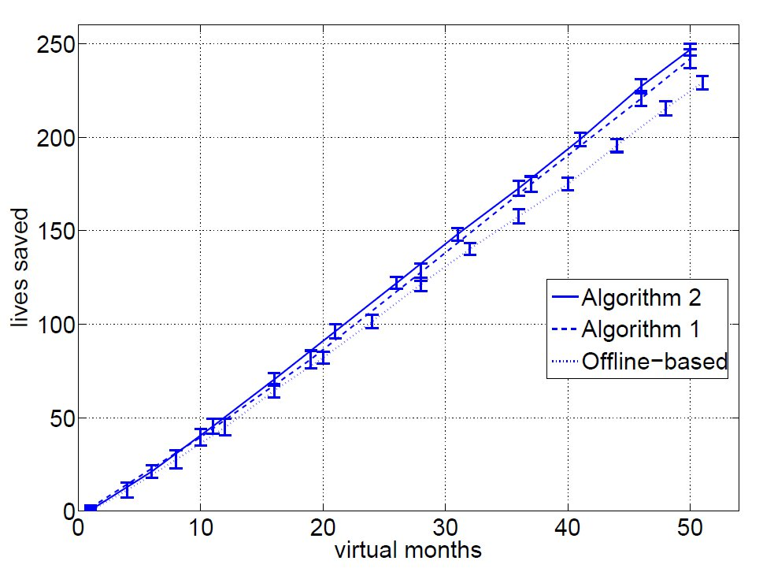
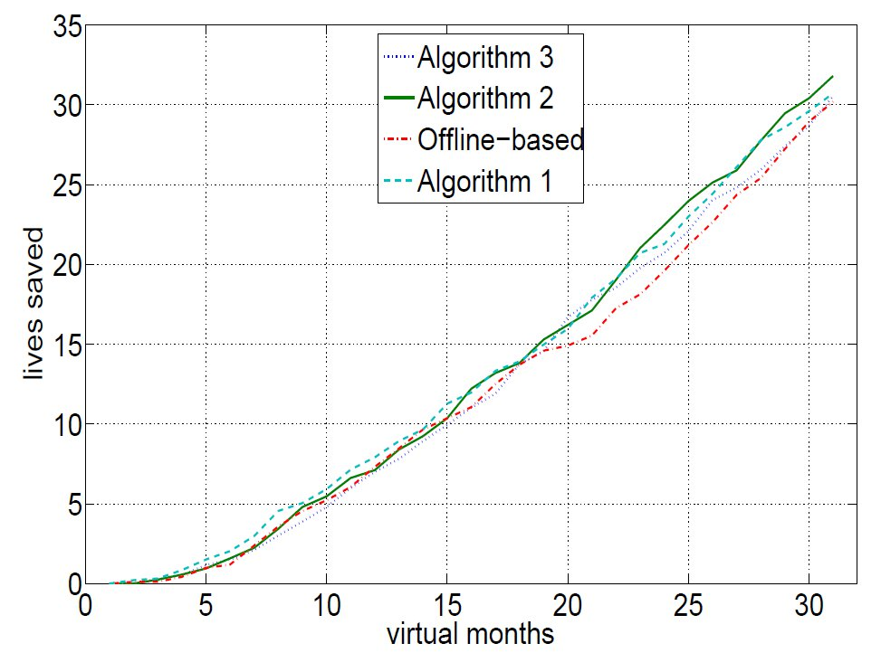
Results
Graphs of performance tuned to optimal parameters
Is it reasonable to compare algorithms that are not normalized (in look-ahead, and no. of samples)
Why use algorithm 3 if it doesn't scale?
Notes:
[andrew] Why does offline algorithm do worse in this case than in the previous paper?

Slide 23
Recap
We examined online stochastic optimization problems for MDPs where randomness is not dependent on past actions
Algorithms like regrets outperform others by maximizing the number of samples taken as well as information extracted from each sample, for each action
In real problems such as online kidney exchange, we make adaptations such as breaking down action space into discrete problems and recombining
For discrete real-time data, batch size and look-ahead are parameters that need to be calibrated
Normalizing performance of algorithms for comparison is important!
Notes:
[andrew]

Slide 24
Questions?
Thanks!

