Slide 1
Simplification Duals Expressiveness
By Scott Kominers
And
Lukens Orthwein

Slide 2
Why Simplify?
Computational Complexity
Eliminating “Bad” Equilibria
Unsophisticated Buyers
Lazy Participants

Slide 3
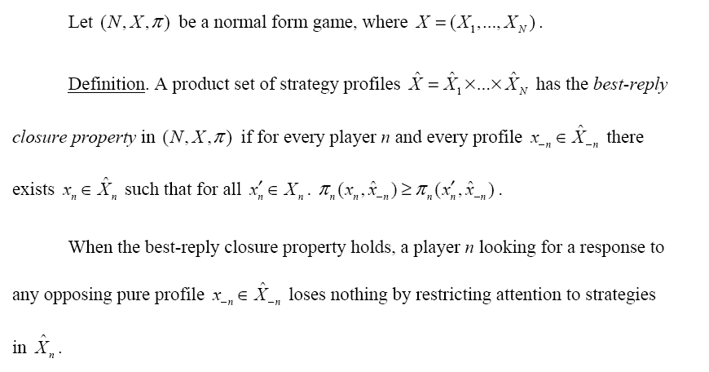
Milgrom’s Simplification Thm.

Slide 4
Milgrom’s Simplification Thm.

Slide 5
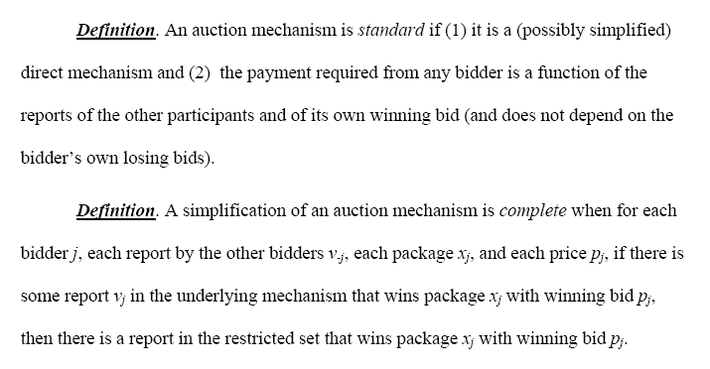
Tractable Simplifications

Slide 6
Simplified Search Auctions
Why they’re desirable
Computational Complexity
Server Load (many keywords per second)
Eliminating “Bad” Equilibria
Low Revenue Equilibria
Unsophisticated Buyers
CS 286r Class (e.g. David Parkes)
Lazy Participants
See above

Slide 7
Bad Equilibria in Search Auct.’s
Vickrey Auction:
Zero Revenue
Repeated Second Price Auction:
Zero Revenue!
Anything Strange Here?

Slide 8
Simplification to the Rescue!
Simplified Vickrey Auction:
Single bid from each buyer
Auctioneer computes bids for all positions
Generalized Second Price Auction:
Single bid from each buyer
Mechanism ranks buyers based on the bids and allocates accordingly w/ Second Price Auction rules
Revenue!

Slide 9
Package Auctions
Why they’re desirable
Computational Complexity
HUGE domain (2^{n} packages)
Eliminating “Bad” Equilibria
Inefficient Equilibria
Unsophisticated Buyers
Don’t know full preference set
Lazy Participants
Don’t care to express full preference set

Slide 10
Simplified Package Auctions

Slide 11
Affine Approximation Mechanisms
Anything Strange Here?

Slide 12
Thoughts?
Theory vs. Practice
Are Some of These Results Coincidental?
How Would You Sell Treasury Bills?

Slide 13
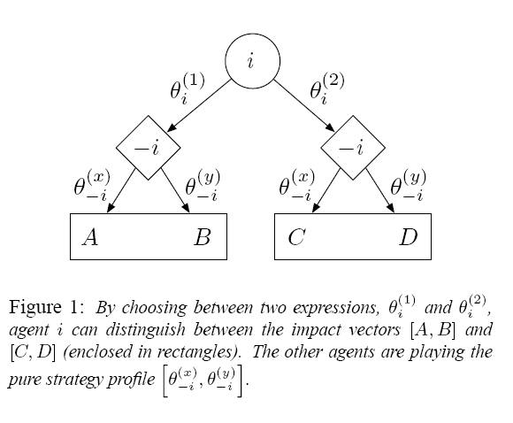
Expressiveness in Mechanisms
What is Expressiveness?
The impact vector represents the effect your action could have on outcomes if you can express it

Slide 14
Maximum Impact Dimension
The most buttons other agents can give you in order to allow you to affect the outcome of the mechanism.
Anything Strange Here???

Slide 15
Shatterable Outcome Dimension
Given a system with a set of rules, how many possible different outcomes can an agent effect?
How about here?

Slide 16
What is the Main Result?
?
Efficiency Benefits
Upper bound on efficiency is strictly monotonic with expressiveness
So what happens in equilibrium?
No idea...

Slide 17
Tradeoffs Between Simplification and Expressiveness
Revenue vs. Efficiency
Tractability vs. Generality
Uncertainty vs. Certainty
What is the true nature of your customer?
Are we encouraging or discouraging entry?

