Slide 1
The Role of Prices in Peer-Assisted Content Distribution
Christina Aperijis
Michael J. Freedman
Ramesh Johari
Presented by: Kyle Chauvin and Henry Xie
October 14, 2009

Slide 2
Roadmap
Bilateral Exchanges
Multilateral Exchanges
Role of Prices
User Incentives
Dynamics
PACE
Simulations
Results
Conclusions

Slide 3
General Idea
P2P Content Sharing
Peers are both demanders and suppliers.
Goods are non-rival and easily divisible. Necessary for P2P content distribution?
Role of prices
In Practice
Care about efficiency, robustness, dynamics, simplicity, practicality.
Usually done via bilateral trade.

Slide 4
Model
Set of Agents | N
Set of Files | F = F_{i} (supply)  T_{i} (demand)
Transfer Rate (file f from i to j) | r_{ijf}
Exchange Ratio | _{ij} = r_{ji} / r_{ij}
Upload Capacities | B_{i}
Download Rate | d_{if} = _{j} r_{jif} for all f
Utility | V_{i} (d_{i})

Slide 5
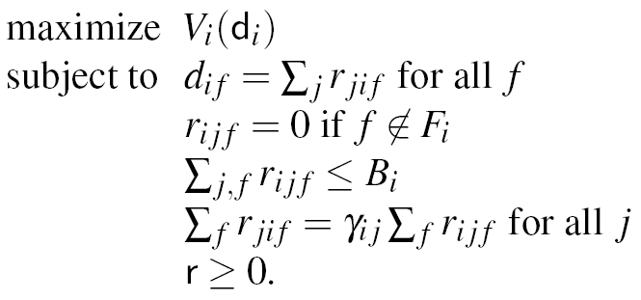
Bilateral Optimization Problem
Agents Solve

Slide 6
A Coincidence of Wants …
1
2
3
4

Slide 7
… Is Coincidental
1
2
3
4

Slide 8
Augmented Model
Set of Agents | N
Set of Files | F = F_{i} (supply)  T_{i} (demand)
Transfer Rate (file f from i to j) | r_{ijf}
Exchange Ratio | _{ij} = r_{ji} / r_{ij}
Upload Capacities | B_{i}
Download Rate | d_{if} = _{j} r_{jif} for all f
Utility | V_{i} (d_{i})
Price | p_{i}

Slide 9
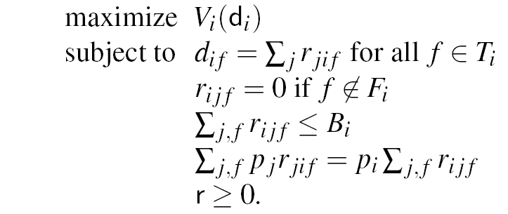
Multilateral Optimization Problem
Agents Solve

Slide 10
CORE
Must respect _{ij} for all j  S
Agents must strictly benefit, but can still interact with S^{c}
CORE vs. Collusion
CORE
Strict Core
Weak Core

Slide 11
Multilateral vs. Bilateral
Multilateral
Outcomes in CORE
Pareto efficient
Equilibria always exist
Trust
Bilateral
Simpler
Equilibria don’t always exist
If exist, not necessarily efficient
Equivalent when
Exchange ratios are ‘fair’: _{ij} = p_{i} / p_{j}
Bilateral with |T_{i}| = |F_{i}| = 1, and in CORE

Slide 12
Role of Prices
Goals
Find market-clearing prices
Efficiency and robustness
Fast convergence to equilibrium
What to price?
One Price per Peer (PP)
One Price per File (PF)
One Price per File per Peer (PFP)
Network Topology
Congestion
Link prices

Slide 13
User Incentives
Prices are Incentives
Provide upload capacity
Share high-value content
Be truthful
Size Effect and Market Power
Economic intuition
No market power if _{d} > B_{i} / ^{k}_{j=1} B_{j}
Rare Files
More market power?
Uploaders create uploaders
Seeders

Slide 14
Dynamics
Price Discovery
Price if excess demand
Price if excess supply
Eqm: Demand = Supply
Peer Discovery
Matching of downloaders to uploaders
PP is fast and simple
Multilateral vs. Bilateral
Can trade before equilibrium is reached
Equilibrium reached faster
Asynchronous download/upload
Tradeoff between performance and simplicity

Slide 15
PACE: Basic Components
Sell Client
Manages prices p⁰_{s} and p¹_{s} for local and global networks by equating supply and demand
Buy Client
Allows user to submit list of desired files and a savings rate
Requests downloads to maximize product of file-level download rates

Slide 16
PACE: Meta-Level Components
Rendezvous Service
Coordinates buy clients searching for files
Network Price Service
Manages price for network links not controlled by users
Bank
Oversees transactions and keeps registry of users (authors imagine most banks will be centralized around a content distributor)

Slide 17
PACE: other concerns
Security:
Ensuring payments are made from buyers to sellers
Coordinating users and centralized banks
Sybil attacks and collusion
Monetary policy
How to incorporate new users

Slide 18
Simulation Analysis
Setup
Large tree-like network with 500 peers
Compares PACE and BitTorrent algorithms
One File
PACE incentivizes freeloaders to still upload
PACE encourages use of local network connections
Two Files
PACE allows for scarce but sought-after files to be transferred more quickly

Slide 19
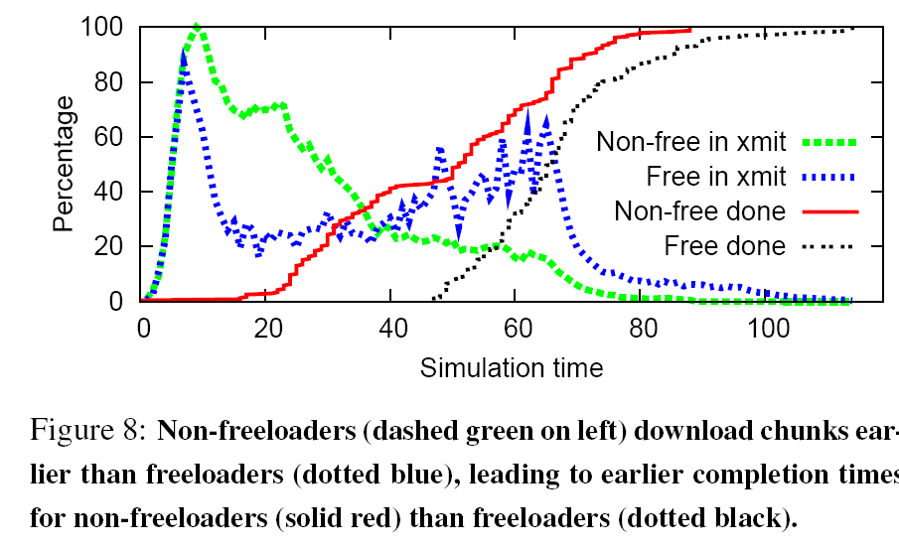
Freeloaders
Freeloaders Pay A Price

Slide 20
Concluding Remarks
Why do we not see more multilateral implementations?
Has PACE been implemented?
What are the implications for non-filesharing P2P systems?
Legal concerns
Malicious users and spread of bad files

