Slide 1
Learning-Augmented Algorithms:
How ML Can Lead to
Provably Better Algorithms
Michael Mitzenmacher
Harvard University

Slide 2
What’s This?

Slide 3
What’s This?
A Mitzenmacher talk should have either

Slide 4
What’s This?
A Mitzenmacher talk should have either
  Bloom Filters, or

Slide 5
What’s This?
A Mitzenmacher talk should have either
  Bloom Filters, or
  The Power of Two Choices

Slide 6
What’s This?
A Mitzenmacher talk should have either
  Bloom Filters, or
  The Power of Two Choices
Don’t worry, this talk will have both.

Slide 7
What’s This?
A Mitzenmacher talk should have either
  Bloom Filters, or
  The Power of Two Choices
Don’t worry, this talk will have both.
Plus some connection to machine learning.

Slide 8
What’s This?
A Mitzenmacher talk should have either
  Bloom Filters, or
  The Power of Two Choices
Don’t worry, this talk will have both.
Plus some connection to machine learning.
Because everything is machine learning these days…

Slide 9
Outline
Toy Example: Scheduling
Queueing
Other Recent Examples
  Online Algorithms: Caching
  Streaming Algorithms: Heavy Hitters
Learned Bloom Filters
Conclusion

Slide 10

Toy Example : Scheduling
Suppose we have two types of jobs, short jobs and long jobs
Goal: Minimize Total Waiting Time
If we don’t know the job sizes, we probably just
  Take jobs in order
  Randomize job order
If we know the sizes, put short jobs first

Slide 11
Learning-Augmented Scheduling
Suppose we have a “learning algorithm” that can predict whether jobs are short or long.
Use the predictor to order the jobs.
Exercise, Left To Reader:
  If short jobs (of size S) are misclassified as long with probability p and long jobs (of size L) are misclassified as short with probability q, what is the expected gain from using the learning algorithm?

Slide 12
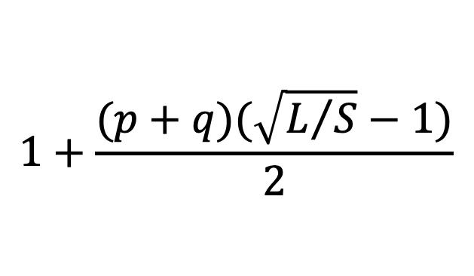
Price of Misprediction
A “competitive ratio” formulation
What is the (worst-case) ratio of the expected total waiting time using the ML algorithm compared to having perfect information?
Exercise Left To Reader, ratio is bounded (asymptotically) by
$$1+\frac{(p+q)(\sqrt{L/S}−1)}{2}$$

Slide 13
Takeaways
Simplistic model
But highlights that even “bad” predictions can be helpful.
And can be considered mathematically.

Slide 14


More Complex Model : Single Queues

Slide 15
Standard Queueing Model
Arrival Process
  Usually Poisson arrivals; exponentially distributed service times
Service Time
  For theory, exponential service times are nice
  In practice, some kind of heavy-tailed distribution
  In simple models, service time is unknown
Service Discipline
  First-In First-Out (FIFO), = First-Come First-Served
  Others possible
  Preemption

Slide 16
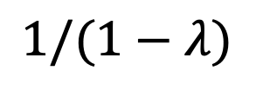
Main Result for Standard Queues
For M/M/1 queues
  FIFO queues
  Poisson arrivals of rate λ < 1
  Exponential service times with mean 1
The steady state expected time in the system is
$$1/(1−λ)$$

Slide 17
Known Service Times
Can do better if service times are known.
  Shortest job first. (Non-preemptive.)
  Shortest remaining processing time. (Preemptive.)
  Preemptive shortest job first. (Preemptive.)
All of these have known formulae for Poisson arrivals, general service time distributions.

Slide 18
Predicted Service Times
Suppose we have an ML algorithm that can predict service times. Then we can consider policies:
  Shortest predicted job first.
  Shortest predicted remaining service time.
  Preemptive shortest predicted job first.
A natural probabilistic model:
  Service distribution given by density function g(x,y), representing density of jobs with true service time x and predicted service time y.

Slide 19
Obvious Shortcoming for SRPT
When a prediction is smaller than a job size, predicted remaining service time will be 0.
Very bad if a big job is predicted small.
We should do something for jobs that sit at the front of the queue with predicted remaining service time 0.
  Left as future work.
  Ideally a good solution would be distribution-independent.

Slide 20
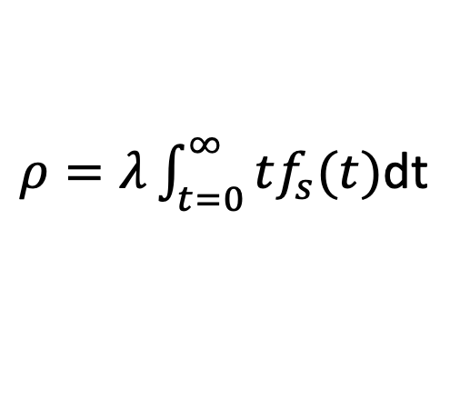
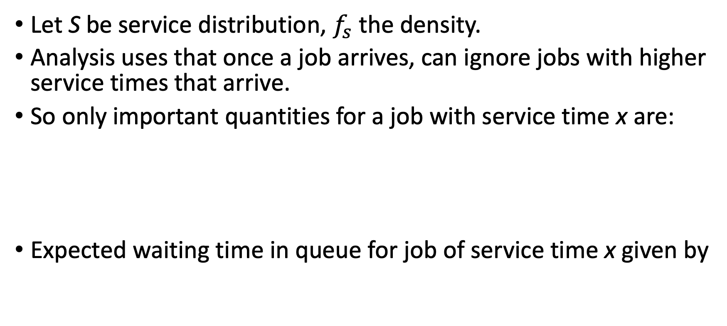
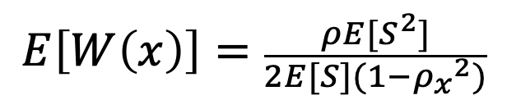

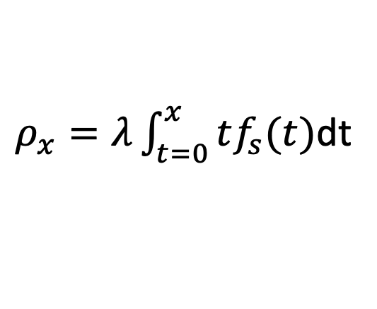
Shortest Job First Queues
Let S be service distribution, $f_{s}$ the density.
Analysis uses that once a job arrives, can ignore jobs with higher service times that arrive.
So only important quantities for a job with service time x are:
Expected waiting time in queue for job of service time x given by
$ρ=λ\int_{t=0}^{∞}{tf_{s}(t)}$dt
Rate of inflow of work
$ρ_{x}=λ\int_{t=0}^{x}{tf_{s}(t)}$dt
Rate of inflow of work for jobs with service $≤x$
$$E\left[W\left(x\right)\right]=\frac{ρE[S^{2}]}{2E[S](1−{ρ_{x}}^{2})}$$

Slide 21
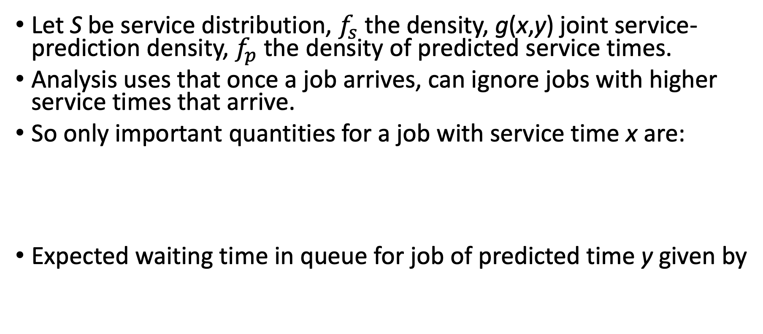
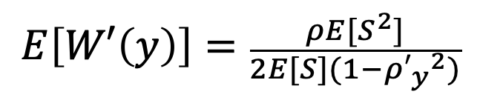
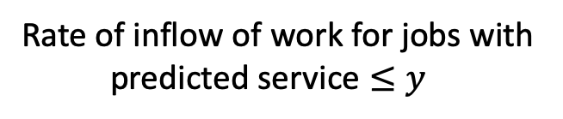
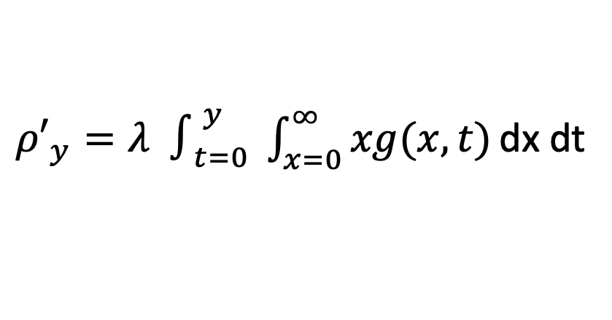
Shortest Predicted Job First Queues
Let S be service distribution, $f_{s}$ the density, g(x,y) joint service-prediction density, $f_{p}$ the density of predicted service times.
Analysis uses that once a job arrives, can ignore jobs with higher service times that arrive.
So only important quantities for a job with service time x are:
Expected waiting time in queue for job of predicted time y given by
$ρ=λ\int_{t=0}^{∞}{tf_{s}(t)}$dt
Rate of inflow of work
${ρ′}_{y}=λ ∫_{t=0}^{y} \int_{x=0}^{∞}{xg(x,t)}\text{d}\text{x}$dt
Rate of inflow of work for jobs with
predicted service $≤y$
$$E\left[W′\left(y\right)\right]=\frac{ρE[S^{2}]}{2E[S](1−{{ρ′}_{y}}^{2})}$$

Slide 22
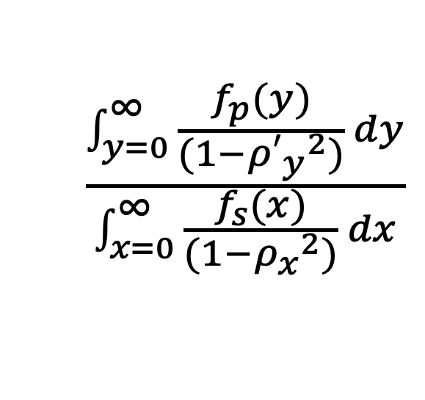
Results
End result: by integrating over service/predicted service times, get a “simple” formula for price of misprediction for shortest job first.
Can perform similar derivations for shortest predicted remaining service times, preemptive shortest predicted job first.
$$\frac{\int_{y=0}^{∞}{\frac{f_{p}(y)}{(1−{{ρ′}_{y}}^{2})}} dy}{\int_{x=0}^{∞}{\frac{f_{s}(x)}{(1−{ρ_{x}}^{2})}} dx}$$

Slide 23
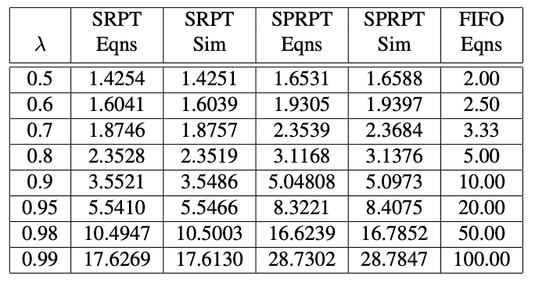
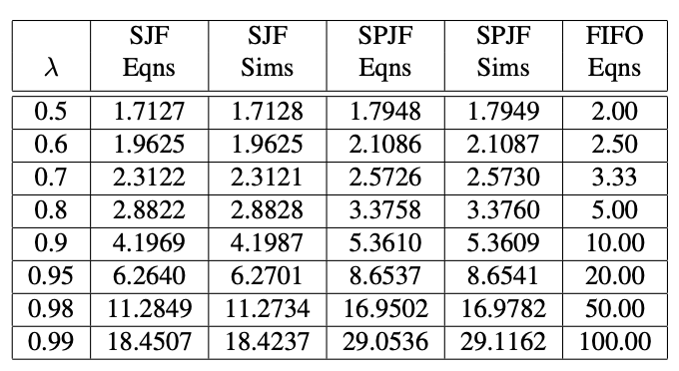
Test Examples
Service times are exponentially distributed, mean 1
Prediction times for a job of true size x is exponentially distributed with mean x
Equations and simulations match.
Significant improvements over no information, especially under high loads.

Slide 24
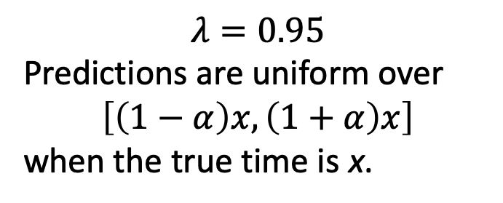
Simulations
$$λ=0.95$$
Predictions are uniform over
$$\left[\left(1−α\right)x,\left(1+α\right)x\right]$$
when the true time is x.

Slide 25
High Level Messages
Preemption is good. (But we knew that.)
Even weak predictions can significantly improve scheduling and queueing.
Intuition: we just want to get the order right!
Analysis possible under reasonable assumptions.
  But seems like a good idea even without full analysis.

Slide 26
Multiple Queues : Power of Two Choices
Imagine a system with n queues, but λn jobs entering per unit time.
Assign jobs randomly, get n parallel M/M/1 queues.
Join the Shortest Queue = fewest jobs well studied.
Power of two choices
  Join the shortest of two (or d) randomly chosen queues.
  Reduces expected time in system exponentially.

Slide 27
Multiple Queues: Known Service Times
If we know the service times, we can track the load (remaining work) at each queue, and choose the least loaded (using power of d choices).
This has been analyzed for FIFO queues.
  But why use FIFO queues if the service times are known?
  Use least loaded + SRPT, for example.
  Simulation show significant gains under high loads.
  Analysis open.
Simulations: d = 2.

Slide 28
Known Service Times, Simulations
Shortest Queue
Least Loaded
Exponential Service Times

Slide 29
Known Service Times, Simulations
Shortest Queue
Least Loaded
Weibull Service Times

Slide 30
Multiple Queues: Predicted Service Times
If we use predicted service times, can use them to
  choose a queue
  order within a queue
  both?
Simulations, d = 2 choices.
Exponential predictions.
  Service times are exponentially distributed, mean 1
  Prediction times for a job of true size x is exponentially distributed with mean x
Least loaded updates
  When job finishes, recompute predicted load at the queue

Slide 31
Predicted Service Times, Simulations
Shortest Queue
Least Loaded
Exponential Service Times
Shortest queue is a little better than least loaded.

Slide 32
Predicted Service Times, Simulations
Shortest Queue
Least Loaded
Weibull Service Times
PSPJF is better than SPRPT.

Slide 33
Summary
Scheduling, load balancing are natural places for learning-augmented algorithms.
  For theory and practice.
Here we consider a probabilistic model.
  Induced distribution from the prediction.
  Leads to exact results in some settings.
Lots of interesting issues left to explore.
  Power of two choices settings with predictions seems complicated in theory, with some practical subtleties.

Slide 34
Online Problems : Caching
Standard online algorithm problem.
Cache of size k.
Elements arrive one after another.
  If an element is in the cache, cost 0.
  If an element is not in the cache, cost 1.
    And can evict an element from the cache, replace it with arrival.
Offline optimal (Belady’s rule)
  Evict item that next appears farthest in the future.
Of course, we don’t know the future.
  But maybe we can predict it.

Slide 35
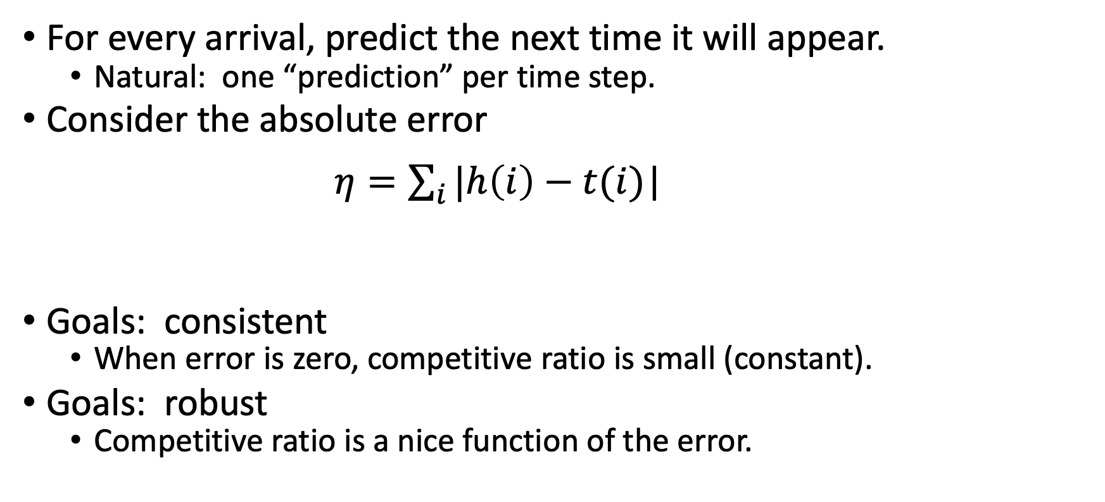
Caching with Predictions [Lykouris-Vassilvitskii]
For every arrival, predict the next time it will appear.
  Natural: one “prediction” per time step.
Consider the absolute error
$η=\sum_{i}{|h\left(i\right)−t(i)}$|
Goals: consistent
  When error is zero, competitive ratio is small (constant).
Goals: robust
  Competitive ratio is a nice function of the error.
Predicted Arrival
Actual Arrival

Slide 36
Caching with Predictions [Lykouris-Vassilvitskii]
First guess: follow the predictions!
  Evict the element predict to appear farthest in the future.
  Exercise: This does very badly.
    Constant average error can lead to super-constant competitive ratio.

Slide 37
Caching with Predictions [Lykouris-Vassilvitskii]
First guess: follow the predictions!
  Evict the element predict to appear farthest in the future.
  Exercise: This does very badly.
    Constant average error can lead to super-constant competitive ratio.
Cache of size 2.
Predictions for b and c are correct.
Prediction is that a is coming next.
a is kept in cache, b and c alternate.
a b c b c b c b c b c ….

Slide 38
Caching with Predictions [Lykouris-Vassilvitskii]
Better approach: Use predictions to enhance an existing competitive algorithm.
Marker algorithm:
  Phases; each phase, all cache entries are unmarked.
  When time to evict, pick a random unmarked entry.
  When an element arrives, mark its cache entry.
  When all entries marked, start a new phase.
Known to be 2H_{k}-competitive.

Slide 39
Caching with Predictions [Lykouris-Vassilvitskii]
Better approach: Use predictions to enhance an existing competitive algorithm.
Marker algorithm with predictions:
  Phases; each phase, all cache entries are unmarked.
  When time to evict, pick a random unmarked entry entry with prediction farthest in the future.
  When an element arrives, mark its cache entry.
  When all entries marked, start a new phase.

Slide 40
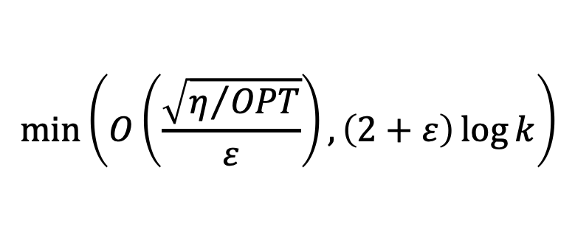
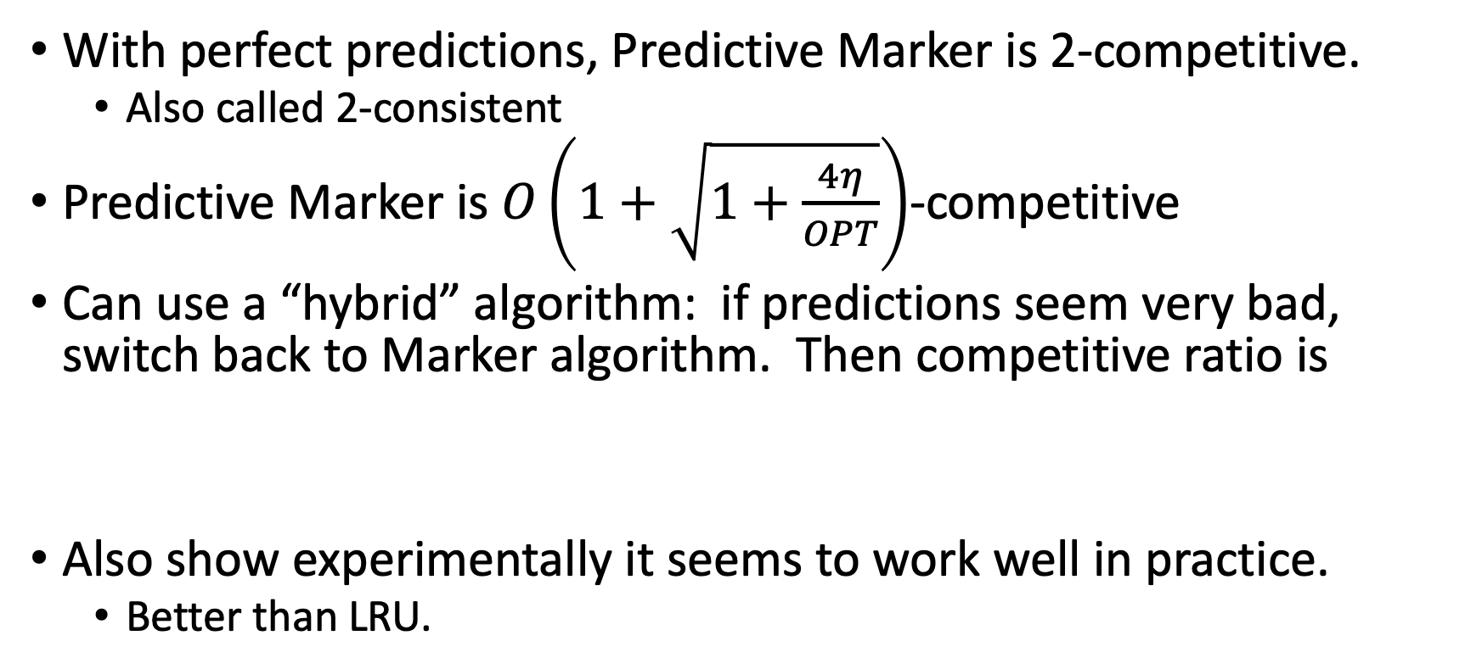
Caching with Predictions [Lykouris-Vassilvitskii]
With perfect predictions, Predictive Marker is 2-competitive.
  Also called 2-consistent
Predictive Marker is $O\left(1+\sqrt{1+\frac{4η}{OPT}}\right)$-competitive
Can use a “hybrid” algorithm: if predictions seem very bad, switch back to Marker algorithm. Then competitive ratio is
Also show experimentally it seems to work well in practice.
  Better than LRU.
$$\min\left(O\left(\frac{\sqrt{η/{OPT}}}{ε}\right),\left(2+ε\right)\log{k}\right)$$

Slide 41
Summary
On-line algorithms are a natural place to use learning-augmented algorithms.
  Notions of consistency, robustness.
Other online problems have been studied in this framework.

Slide 42
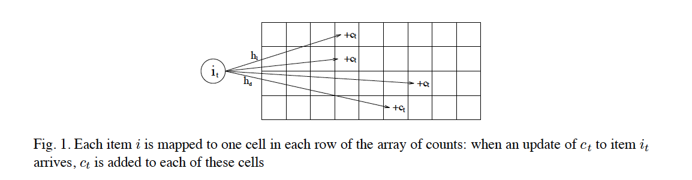
Frequency Estimation with Predictions
[Aamand-Indyk-Valkian][Hsu-Indyk-Katabi-Valkian]
Many frequency estimation algorithms based on count-based sketches
  Count Min, Count Sketch
  Algorithms approximate counts for items

Slide 43
Streaming Algorithms:
Frequency Estimation with Predictions
Problem with sketches: collisions
  Low-count items return high counts if they collide with some high-count item in each row.
  Not frequent, but leads to large error.
If we could remove high-count items from consideration, better results all around.
  Do explicit counts for some items, sketch the rest.
If we have a predictor for high-count items, use the predictor to decide what to remove for explicit counts.

Slide 44
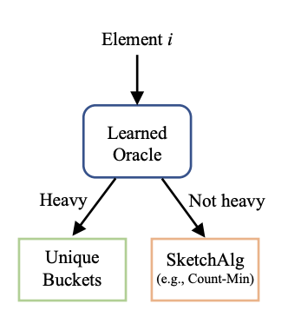
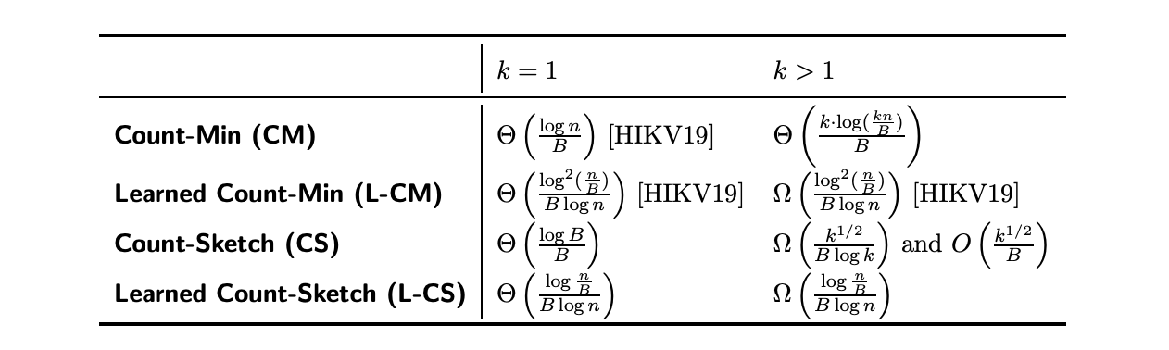
Frequency Estimation with Predictions
Theoretical Results for Zipfian Distributions
k is number of hash functions
B is number of buckets

Slide 45
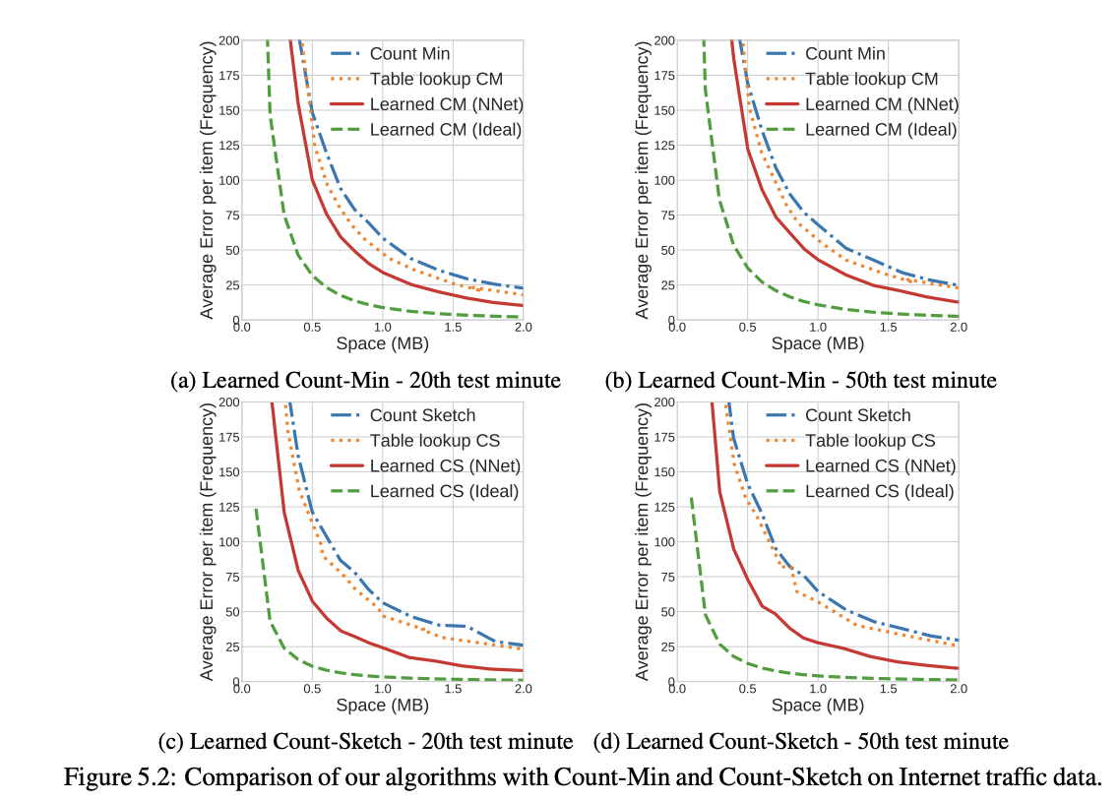
Empirical Results

Slide 46
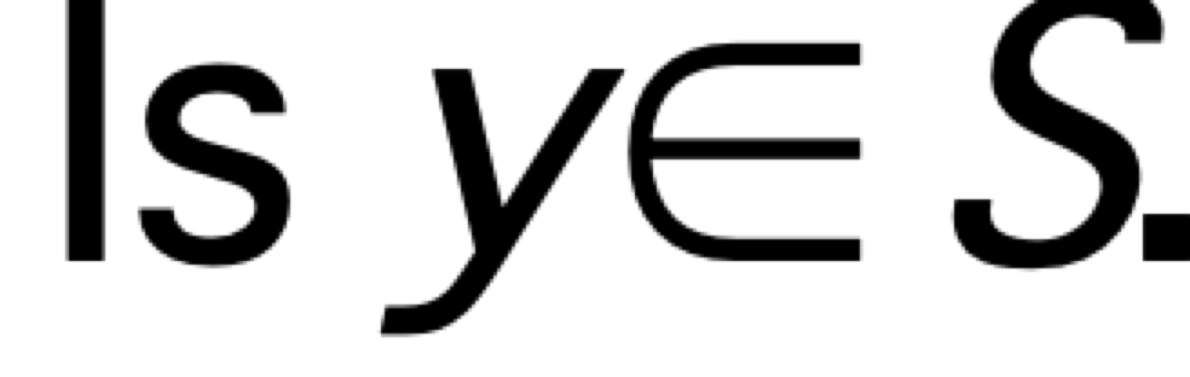
Bloom Filters:
Approximate Membership Queries
Given a set S = {x₁,x₂,x₃,…x_{n}} on a universe U, want to answer membership queries of the form:
Data structure should be:
  Fast (Faster than searching through S).
  Small (Smaller than explicit representation).
To obtain speed and size improvements, allow some probability of error.
  False positives: y ∉ S but we report y ∈ S
  False negatives: y ∈ S but we report y ∉ S

Slide 47
Bloom Filters
Start with an m bit array, filled with 0s.
B
0
0
0
0
0
0
0
0
0
0
0
0
0
0
0
0
Hash each item x_{j} in S k times. If H_{i}(x_{j}) = a, set B[a] = 1.
B
0
1
0
0
1
0
1
0
0
1
1
1
0
1
1
0
To check if y is in S, check B at H_{i}(y). All k values must be 1.
B
0
1
0
0
1
0
1
0
0
1
1
1
0
1
1
0
Possible to have a false positive; all k values are 1, but y is not in S.
B
0
1
0
0
1
0
1
0
0
1
1
1
0
1
1
0
n items m = cn bits k hash functions

Slide 48
False Positive Probability
Pr(specific bit of filter is 0) is
If ρ is fraction of 0 bits in the filter then false positive probability is
Approximations valid as ρ is concentrated around E[ρ].
  Martingale argument suffices.
Find optimal at k = (ln 2)m/n by calculus.
  So optimal fpp is about (0.6185)^{m/n}
n items m = cn bits k hash functions

Slide 49
Example
m/n = 8
Opt k = 8 ln 2 = 5.45...
n items m = cn bits k hash functions

Slide 50
Learned Bloom Filters
[Krasksa et al] suggests can do better than standard Bloom filters
  In a data dependent way
  Assuming you can “learn” the set from the Bloom filter
Use machine learning to develop a small-size oracle that provides probability an element is in a set
  Oracle should (hopefully) give few false positives
  And you need a backup to catch any false negatives.

Slide 51
Learned Bloom Filters: Setup
Bloom filters as binary classification problem
Use set of elements as a collection of positive examples.
Use set of non-elements as a collection of negative examples.
  Can be chosen non-elements, or random non-elements.
Derive neural network with sigmoid activation to produce a “probability estimate” than an input is in the set, minimizing log loss.
Choose a threshold.
  Elements evaluated above the threshold are assumed positive; below the threshold are assumed negative.
May be false positives, and false negatives.

Slide 52
Learned Bloom Filter: Improved Setup
Input
Items that the oracle says are likely
positives are treated as positives.
Causes false positives.
Items that oracles says are negative might include false negatives! So we have a
backup Bloom filter to catch false
negatives in the set. Causes additional false positives, avoids false negatives.
Learned Oracle
Positives
Negatives
Backup Filter
Positives
Negatives

Slide 53
False Positives vs. “False Positives”
Both standard and learned Bloom filters have false positives
  But terms means different things.
For a Bloom filter, the false positive probability is the probability any non-set item yields a false positive
For a learned Bloom filter, the false positive probability is an empirical estimate, assuming your future data looks like the training data used to create the filter.
  Big assumption, not suitable for many applications.
  Proposed solution – if the false positives become too high, retrain. (Not a great solution?)

Slide 54
Example
Universe is [1,1000000].
Bloom filter holds 500 random keys from [1000,2000].
So learned Bloom filter might accept all keys from [1000,2000].
  Can’t “learn” random behavior in this range.
False positive probability depends on query range/distribution.
  If queries are uniform over whole space, very low.
  If queries are uniform over [1,100000], now false positives about ten times larger.

Slide 55
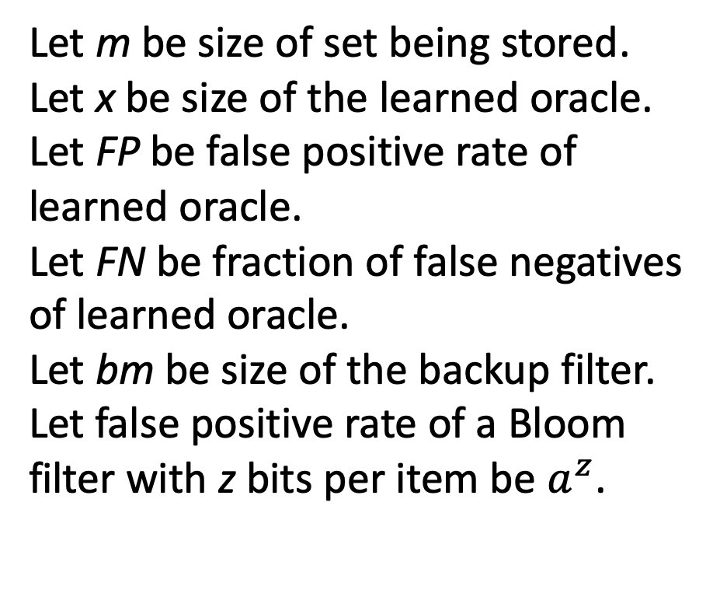
Learned Bloom Filter Analysis
Input
Let m be size of set being stored.
Let x be size of the learned oracle.
Let FP be false positive rate of learned oracle.
Let FN be fraction of false negatives of learned oracle.
Let bm be size of the backup filter.
Let false positive rate of a Bloom filter with z bits per item be $a^{z}$.
Learned Oracle
Positives
Negatives
Backup Filter
Positives
Negatives

Slide 56
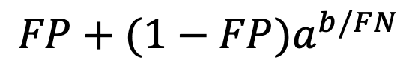
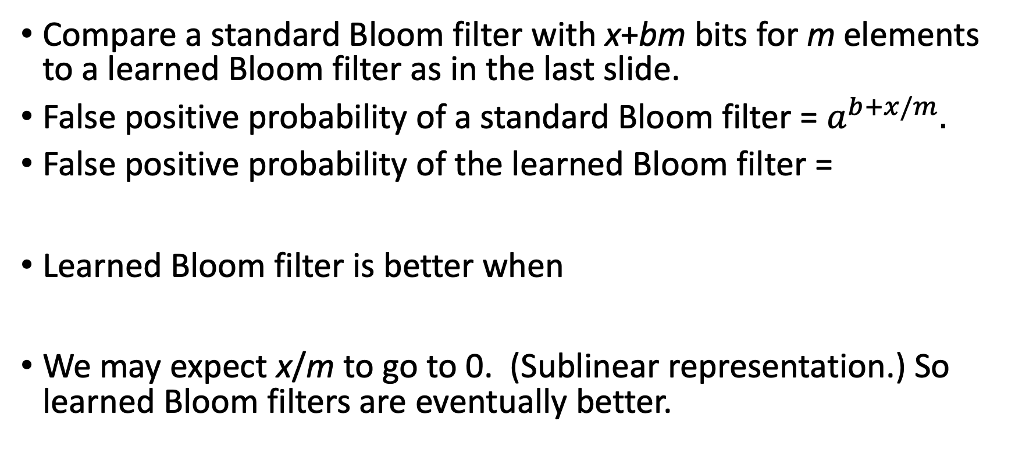
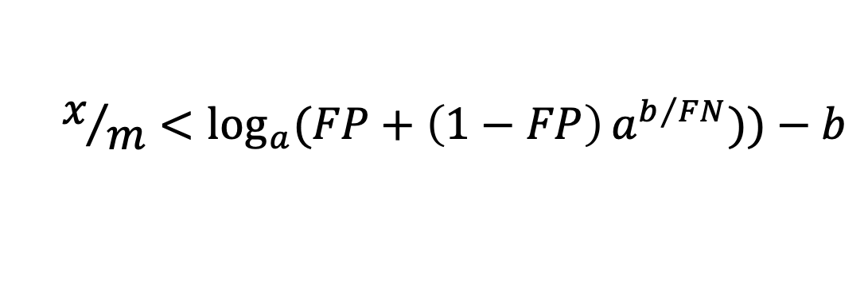
A Basic Comparison
Compare a standard Bloom filter with x+bm bits for m elements to a learned Bloom filter as in the last slide.
False positive probability of a standard Bloom filter = $a^{b+x/m}.$
False positive probability of the learned Bloom filter =
Learned Bloom filter is better when
We may expect x/m to go to 0. (Sublinear representation.) So learned Bloom filters are eventually better.
$$FP+(1−FP)a^{b/FN}$$
$$x/m<\log_{a}{(FP+\left(1−FP\right)}a^{b/{FN}}))−b$$

Slide 57
Other Ideas
Sandwiched Learned Bloom Filter
Learned Bloomier Filter
Input
Input
Negatives
Initial Filter
Learned Oracle
Positives
Learned Oracle
Positives
Bloom Filter
Passed (yields
false positives)
Negatives
Hit
Negatives
Backup Filter
Positives
Negatives
Backup Bloomier Filter
Positives

Slide 58
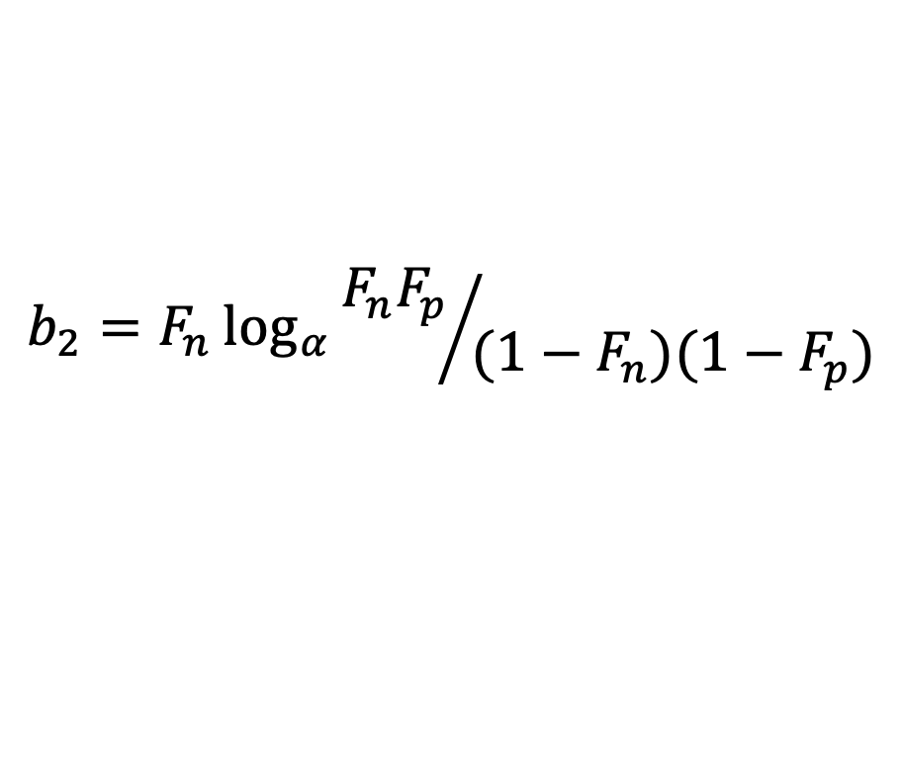
Sandwiched Bloom Filter
Initial filter gets rid of lots of negatives early
Backup filter brings back in false negatives, creates false positives
First part is more important; backup filter can’t create many false positives when initial filter removes so many.
Technical result: if you have a “bit budget” for the Bloom filter of b₂m bits, use b₂m for the backup filter, where
Note b₂ independent of b!
$$b_{2}=F_{n}\log_{α}{{F_{n}F_{p}}/{(1−F_{n})(1−F_{p})}}$$

Slide 59
Related Themes: Advice
Online Algorithms with Advice, e.g. [Dobrev et al]
Complexity of optimal advice
Caching: 1 bit per item needed
  Keep item in the cache until its next request, or not.
Single-queue scheduling: constant bits per item on average
  Give position in queue
Learning-augmented algorithms focus on practical but noisy advice.

Slide 60
Related Themes: Beyond Worst Case Analysis
Subcommunity of algorithmists looking beyond worst case analysis.
  Pushed by (among others) Tim Roughgarden.
  Several classes on this theme.
  A book coming shortly!
Learning-augmented seems like a potentially very general and powerful paradigm for BWCA algorithms.

Slide 61
Where Else to Look…
Sergei Vassilvitskii’s HALG talk, What Can ML Do for Algorithms?
  http://theory.stanford.edu/~sergei/slides/HALG-slides.pdf
Daskalakis and Indyk’s course at MIT, Learning-Augmented Algorithms
  https://stellar.mit.edu/S/course/6/sp19/6.890/materials.html
TTIC Summer Workshop on Learning-Based Algorithms
  https://www.mit.edu/~vakilian/ttic-workshop.html

Slide 62
Lots of Questions
What problems are amenable to advice from learning algorithms?
What should be predicted – is it realistic?
Can we give feedback to the ML community?
  Can you optimize for this measure when learning?
  How quickly can we figure out when inputs aren’t being predicted appropriately?
Price of misprediction: appropriate definition?

