Slide 1

The Last Day
CS 161: Lecture 19
4/25/17

Slide 2




Goals
Take unmodified POSIX/Win32 applications . . .
Run those applications in the cloud . . .
On the same hardware used to run big-data apps . . .
. . . and give them cloud-scale IO performance!

Slide 3
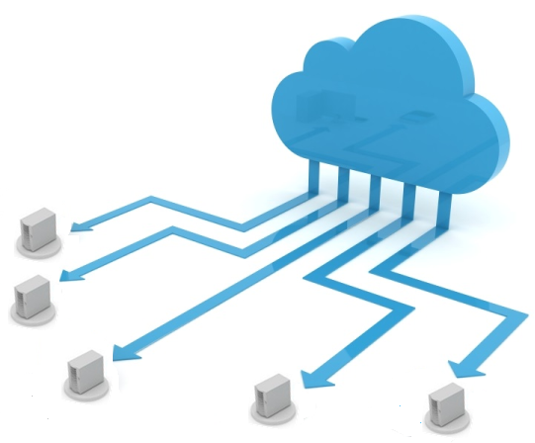

Goals
Take unmodified POSIX/Win32 applications . . .
Run those applications in the cloud . . .
On the same hardware used to run big-data apps . . .
. . . and give them cloud-scale IO performance!
  Throughput > 1000 MB/s
  Scale-out architecture using commodity parts
MapReduce

Slide 4
Why Do I Want To Do This?
Write POSIX/Win32 app once, automagically have fast cloud version
Cloud operators don’t have to open up their proprietary or sensitive protocols
Admin/hardware efforts that help big data apps help POSIX/Win32 apps (and vice versa)

Slide 5
Naïve Solution: Network RAID
Blizzard virtual drive
Remote disks

Slide 6

LISTEN
The naïve approach for implementing virtual disks does not maximize spindle parallelism for POSIX/Win32 applications which frequently issue fsync() operations to maintain consistency.

Slide 7
LISTEN
The naïve approach for implementing virtual disks does not maximize spindle parallelism for POSIX/Win32 applications which frequently issue fsync() operations to maintain consistency.
IOp dilation:
Nested striping
Excellence
fsync() write barriers:
Delayed durability semantics
Rack locality:
Locality-oblivious storage
Notes:
I’ll describe three technical challenges and three solutions. First, I’ll describe a phenomenon called IOp convoy dilation. Dilation causes non-optimal seek behavior on remote disks, and limits throughput for sequential read and write workloads. I’ll describe how a data placement strategy called nested striping can avoid this problem. Next, I’ll describe how traditional datacenter networks with oversubscribed network links constrain the disk parallelism available to POSIX workloads. I’ll explain how Blizzard can use locality-oblivious storage, first proposed by FDS, to solve this problem. Finally, I’ll describe how fsync() operations act as write barriers, constraining how many parallel IOs a client can issue. I’ll describe how we can remove these write barriers by decoupling the notion of ordering and durability. This allows Blizzard to immediately acknowledge write requests while still maintaining consistency.

Slide 8

Internet
IP router
IP router
Datacenter
boundary
Intermediate switch
Intermediate switch
Intermediate switch
Intermediate switch
Intermediate switch
Intermediate switch
Top-of-Rack switch
Top-of-Rack switch
. . .
Top-of-Rack switch
Top-of-Rack switch
…
…
…
…
Notes:
Redundant links help if a switch or a link fail. Redundant links also help to deal with hot spots.

Slide 9
X
Y
Virtual disk
Remote disks
Notes:
The virtual disk represents a linear range of bytes. We take that range, divide it into blocks, and stripe those blocks across remote drives. Let’s focus on the last two blocks in that range, which we’ll call X and Y.

Slide 10
X
Y
Virtual disk
Y
Remote disks
X
Disk arm
Notes:
If we look inside the remote disk, we’ll see that X and Y are stored in adjacent locations within the same track.

Slide 11
X
Y
Y
X
Disk arm
Notes:
So, what happens if the client performs a sequential scan of virtual disk?

Slide 12
Client App
X
Y
IO queue
fwrite(W_{X})
(W_{Y})
(W_{X})
fwrite(W_{Y})
Client OS
Y
send(W_{X})
X
send(W_{Y})
Time
Network
W_{X}
W_{Y}
Server OS
fwrite(W_{X})
fwrite(W_{Y})
Notes:
Here’s what happens over time. First, an application like SQL issues two IOs, one for X and one for Y. ****** Then, the client OS issues network sends for those operations. ****** Then, the network delivers those operations to the OS on the remote server. ****** Finally, the remote server issues the operations to the local disk. The thing to notice is that, due to the vagaries of the universe, the temporal gap between the two IOs will often increase at each step along the way. For example, even though SQL may perceive that it issued two writes immediately, those writes may not hit the client’s network card at the same time, due to scheduling jitter on the client. As the operations travel across the network, they may also spread out due to queuing delays. Also, the remote server is handling requests from multiple clients, so there’s scheduling jitter there as well. What’s this all mean? ****** Well, the disk has an IO queue. In the ideal world, ***** the two IOs arrive at the queue at the same time. ****** That allows a single head sweep to handle both writes.

Slide 13
IOp Convoy
Dilation
Client App
IO queue
fwrite(W_{X})
(W_{Y})
(W_{X})
fwrite(W_{Y})
Client OS
Y
fwrite(W_{X})
X
fwrite(W_{Y})
Time
Network
The two writes may have to pay two rotational latencies
fwrite(W_{X})
fwrite(W_{Y})
Server OS
fwrite(W_{X})
fwrite(W_{Y})
Notes:
However, ****** if the two operations are spread in time, then the disk head will start moving and handle the operation to X, but by the time that Y arrives, the disk head will be out of position. ******* This means that we’ll have to pay additional seek costs to move disk arm back to Y. We call this effect IOp convoy dilation.

Slide 14
Fixing IOp Convoy Dilation
Segment size = 4
Virtual drive
Remote disks
Notes:
There’s a pretty simple way to address the problem. We take the simple linear mapping that I showed you before, and we change it to look like this, such that adjacent blocks are mapped to different disks. In this example, we say that we have a segment size of 4, meaning that up to 4 sequential IOs will be handled by 4 different disks.

Slide 15
Fixing IOp Convoy Dilation
Segment size = 4
Virtual drive
Random *and* sequential IOs hit multiple spindles in parallel—seeks and rotational latencies paid in parallel, not sequentially!
Remote disks
Notes:
What’s nice about this scheme is that now random *and* sequential IOs hit multiple spindles. These helps to mitigate the impact of IOp dilation. Even if sequential requests get spread out as they leave the clients, those requests will still hit multiple drives, and have some hope of being handled in parallel. So, that’s how we address the IOp dilation problem.

Slide 16
Rack Locality
20 Gbps cross-rack
10 Gbps to all rack peers
10 Gbps to all rack peers
Notes:
The next challenge is rack locality. In some datacenter architectures, it’s much faster for a machine to talk to a peer inside of its own rack than to a peer that’s outside of the local rack. This is because cross-rack links are oversubscribed. In this example, any two machines that are inside of the same rack can communicate at full 10 Gbps speeds. However, there’s only 20 Gbps of bandwidth *between* the two racks. So, if all four machines in the left rack try to talk to all four machines on the right, we get a traffic jam.

Slide 17


Rack Locality In A Datacenter
Segment size = 4
Virtual drive
Blizzard client
Rack 1
Rack 2
Remote disks

Slide 18
Flat Datacenter Storage (FDS)
Idea 1: Build a datacenter network with full-bisection bandwidth (i.e., no oversubscription)
  Half of the servers can simultaneously communicate with the other half, and the network won’t melt
  In other words, the core of the network has enough bandwidth to handle ½ the sum of the servers’ NIC speeds
Idea 2: Give each server enough NICs to be able to read/write the server’s disks at full sequential speeds
  Ex: If one disk has sequential r/w bandwidth of 128 MB, and a server has 10 disks, give the server 10 x 128 MB = 10 Gbps NIC
Result: Locality-oblivious remote storage
  Any server can access any disk as fast as if the disk were local (assuming datacenter RTTs << than seek+rotational delays)
  FDS is useful for big data applications like MapReduce too!

Slide 19
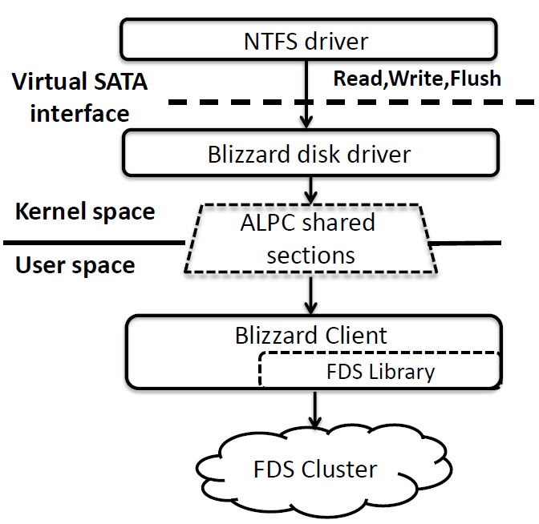
Blizzard as FDS Client
Blizzard client handles:
  Nested striping
  Delayed durability semantics
Zero-copy buffer shared by kernel and user-level code!
FDS provides:
  Locality-oblivious storage
  RTS/CTS to avoid edge congestion

Slide 20
The problem with fsync()
Used by POSIX/Win32 file systems and applications to implement crash consistency
  On-disk write buffers let the disk acknowledge a write quickly, even if the write data has not been written to a platter!
  In addition to supporting read() and write(), the disk also implements flush()
    The flush() command only finishes when all writes issued prior to the flush() have hit a platter
  fsync() system call allows user-level code to ask the OS to issue a flush()
  Ex: ensure data is written before metadata
Write
Write
data
fsync()
metadata

Slide 21

WRITE BARRIERS RUIN BIRTHDAYS
Stalled operations limit parallelism!
W_{A}
W_{B}
W_{C}
W_{D}
W_{E}
W_{F}
F
Time

Slide 22
Delayed Durability in Blizzard’s Virtual Drive
Decouple durability from ordering
Acknowledge flush() immediately . . .
  . . . but increment flush epoch
  Tag writes with their epoch number, asynchronously retire writes in epoch order

Slide 23
Delayed Durability in Blizzard’s Virtual Drive
Decouple durability from ordering
Acknowledge flush() immediately . . .
  . . . but increment flush epoch
  Tag writes with their epoch number, asynchronously retire writes in epoch order
W_{Y}
F₁
W_{X}
W_{Y}
F₂
W_{Y}
₀
₁
₁
₂
App
Blizzard
W_{Y}
W_{Y}
W_{X}
W_{Y}
₀
₀
₁
₁
Remote
W_{Y}
₁
disk
Notes:
Here we see a client application, a Blizzard virtual drive, and a remote disk that provides physical backing storage. ***** The application issues the first write to block Y, and Blizzard acknowledges that write to the application, even though no write has been issued to remote storage. ***** The application issues a flush operation, and Blizzard acknowledges the flush immediately as well, incrementing the flush epoch by one. *****The application issues a write to block X, and Blizzard acknowledges the write immediately. *****At this point, Blizzard decides to issue the first write to Y. ******Then, the client issues another write to Y. ****** Here, Blizzard learns that the first write to Y has become durable. Remember that Blizzard retires writes in epoch order. So, at this point, all writes in epoch 0 have completed. So, Blizzard is free to issue all writes from epoch 1 ****** and that’s what Blizzard does. ****Blizzard receives another flush request, which is acknowledged immediately and causes the epoch number to be incremented. ****** Another write comes in, which is acknowledged immediately, *****and then Blizzard receives confirmation for the write to Y from epoch 1.

Slide 24

Delayed Durability in Blizzard’s Virtual Drive
All writes are acknowledged . . .
. . . but only and are durable!
Satisfies prefix consistency
  All epochs up to N-1 are durable
  Some, all, or no writes from epoch N are durable
  No writes from later epochs are durable
Prefix consistency is good enough for most apps, provides much better performance!
W_{Y}
W_{Y}
₀
₁
Decouple durability from ordering
Acknowledge flush() immediately . . .
  . . . but increment flush epoch
  Tag writes with their epoch number, asynchronously retire writes in epoch order
W_{Y}
F₁
W_{X}
W_{Y}
F₂
W_{Y}
₀
₁
₁
₂
App
Blizzard
W_{Y}
W_{Y}
W_{X}
W_{Y}
₀
₀
₁
₁
Remote
W_{Y}
₁
disk
Notes:
Now, suppose that Blizzard crashes at this point. ***** Note that all writes have been acknowledged to the client, but only the first and second writes to Y are durable. This is actually okay, because Blizzard has provided something known as prefix consistency. If we look at which writes become durable, then all writes up to some epoch N-1 are durable; some, all, or no writes from epoch N are durable; and no writes from subsequent epochs are durable. Essentially, Blizzard has lengthened the window of potential data loss in exchange for much better performance. In practice, many applications are happy with this consistency model. Of course, you might be thinking . . .

Slide 25

Isn’t Blizzard buffering a lot of data?
Epoch 3
Cannot issue!
Epoch 2
Epoch 1
Epoch 0
In flight . . .
Notes:
. . . doesn‘t Blizzard have to buffer a lot of data? After all, Blizzard retires writes in epoch order. ***** So, in this example, while Blizzard is waiting for epoch 0 to become durable, *****epochs 1, 2, and 3 can’t issue, and must be buffered in memory. If Blizzard crashes, it will still provide prefix consistency, but the buffered writes will be lost. So, how can we reduce the amount of buffering? Well . . .

Slide 26
Log-based Writes
Treat backing FDS storage as a distributed log
  Issue block writes to log immediately and in order
  Blizzard maintains a mapping from logical virtual disk blocks to their physical location in the log
  On failure, roll forward from last checkpoint and stop when you find torn write, unallocated log block with old epoch number
Recovered
Roll-forward
Lost
stops, next
write goes here
Write
W₀
W₁
W₂
W₃
stream
Remote
W₀
W₁
W₃
log

Slide 27
Summary of Blizzard’s Design
Problem: IOp Dilation
Solution: Nested striping
Problem: Rack locality constrains parallelism
Solution: Full-bisection networks, match disk and network bandwidth
Problem: Evil fsync()s
Solution: Delayed durability (note that the log is nested-striped)
Virtual drive
Remote disks
FDS
Write
W₀
W₁
W₂
W₃
stream
Remote
W₀
W₁
W₃
log
Notes:
So, in summary, I’ve described three aspects of Blizzard’s design. To solve the IOp dilation problem, Blizzard employs nested striping, which uses write-through IOs to remote disks. To prevent rack locality from constraining IO parallelism, Blizzard uses an FDS-style hardware architecture that provides a locality-oblivious storage substrate. Finally, to eliminate the write barriers induced by fsync()s, Blizzard uses delayed durability semantics to immediately acknowledge writes and flushes while still providing prefix consistency.

Slide 28

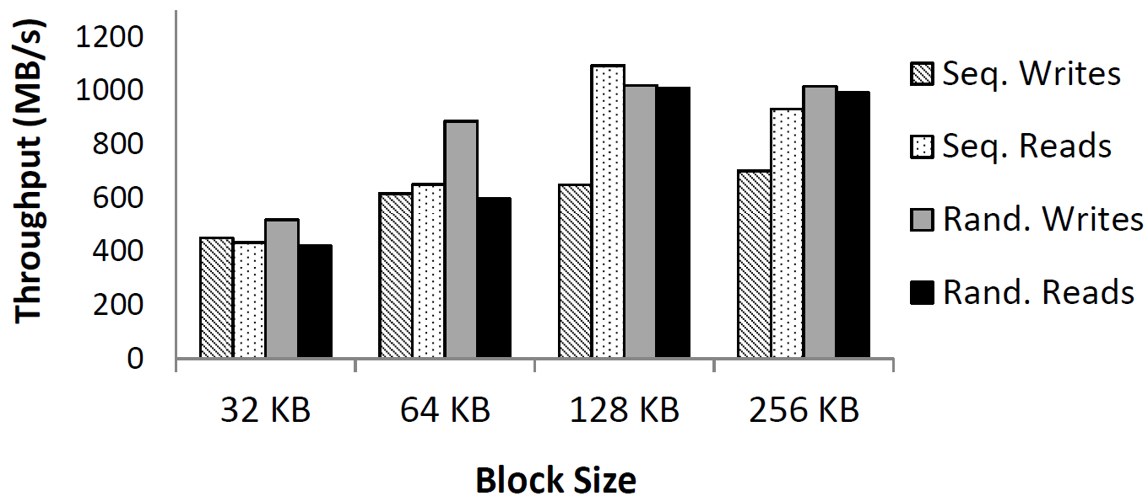
Throughput Microbenchmark
Application issues a bunch of parallel reads or writes
  In this experiment, we use nested striping but synchronous write-through (i.e., no delayed durability tricks—a write does not complete until it is persistent)
  Blizzard virtual disk backed by 128 remote physical disks, and used single replication
Perf bug in storage controller :-(
Notes:
In this microbenchmark, we look at Blizzard’s throughput for reads and writes of various sizes. In these experiments, the virtual drive was backed by 128 remote disks, and Blizzard used nested striping, with none of the delayed durability tricks. Note that nested striping uses write-through operations on remote disks, so the virtual drive did not receive an acknowledgement for a write until that write was persistent on a remote disk. So, these throughput numbers represent Blizzard’s maximum “true” throughput, regardless of delayed durability tricks that may drive up the application’s perceived throughput. We see that, as block sizes get bigger (and more data is returned per remote disk seek), Blizzard’s throughput can reach 1000 MB/s or more. ***** Note that sequential writes are sometimes slower than they should be due to a bug in the storage controller for our servers, but that’s not a fundamental problem with Blizzard’s architecture.

Slide 29
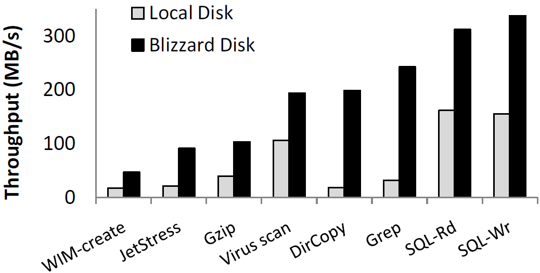
Application Macrobenchmarks
(Write-through, Single Replication)
Notes:
Here we see a bunch of application-level MACRO-benchmarks for performance. Here, throughput is measured from the application’s perspective, e.g., how many megabytes per second a gzip process can scan. The results compare a Blizzard drive and a single, local physical disk. I won’t go into detail about these results, but suffice it to say that they show the expected outcome--if you stripe application IOs across multiple remote disks instead of just one local disk, you’ll see nice performance gains, anywhere from two x to ten x.

Slide 30
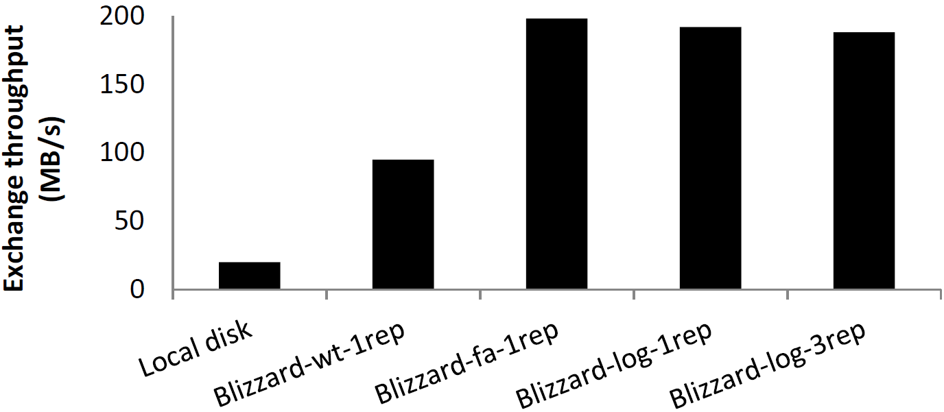
Delayed Durability: Hiding Replication Penalties
fa=“fast acknowledgment” (i.e., delayed durability but no log-based writes)
Just as fast as fast ack, but has to buffer less data (and thus loses less data after crash)
Notes:
Here, we show a cool property of delayed durability---it can hide the penalty of data replication, since a write that is replicated N-times can return immediately, without waiting for the slowest replica to finish. Here, we compare the performance of the Exchange email server on a local disk, and on several variants of Blizzard. ****** We see that Blizzard in write-through, nested-striping mode with single replication provides a 4x throughput improvement over a local physical disk. ***** If Blizzard runs in single replication mode with fast acknowledgments of flush operations, Blizzard provides a 9x improvement compared to a local physical disk. ****** Compared to single replication mode with fast acknowledgement, the log-based fast acknowledgement scheme is just as fast, even if Blizzard uses triple-replication. Note that the log-based scheme isn’t faster than the vanilla delayed-durability scheme because both schemes immediately acknowledge writes and flushes. However, the log-based scheme loses less data in a crash, because it issues writes immediately, without waiting for old epochs to retire. In the paper, we provide a more detailed loss analysis.

