Slide 1
Security
CS 161: Lecture 17
4/18/17
Notes:
Lecture 17

Slide 2
What Hollywood thinks computer security is about

Slide 3
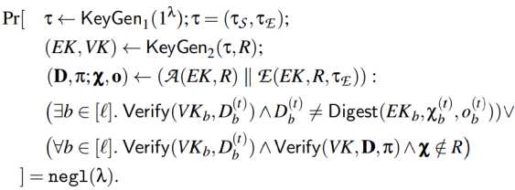
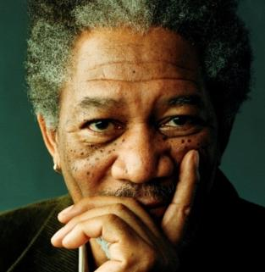
Understanding how systems work
Theoretical cryptography
App
App
App
OS
Hardware
Understanding humanity
Applied cryptography
What computer security is really about

Slide 4
Race Conditions: Non-atomic System Call Pairs
//Process X
sys_call0();
sys_call1();
//Process Y
do_evil()
sys_call0();
sys_call0();
sys_call1();
sys_call1();
do_evil()
do_evil()
Time
Time
sys_call0();
sys_call1();
do_evil()
Time

Slide 5
Linux: Mapping Humans to Privileges
Each user has a user ID (UID), with root having UID 0
Each user also has a group ID (GID), but we’ll mostly ignore groups today
Each file has:
Read/write/execute permissions for the file’s owner, the file’s group, and the world (i.e., all other users)
Set-user-id bit: 1 if the file should be executed with the owner’s permissions (shows up as “s” instead of “x” in “ls –l” output); 0 if the file should be executed with launching user’s permissions
$ ls -l a.out
-rwxr-xr-x 1 mickens somegrp 524288 Jan 19 11:35
User
Owner
Group
Owner
group
World

Slide 6
Linux: Mapping Humans to Privileges
Each process has a bunch of IDs, including:
Real UID: The UID of the process owner
Effective UID: The UID that the kernel checks when validating access permissions
On fork(), the child inherits the UIDs of its parent
On exec(progName), the process keeps its UIDs unless the progName file has the set-user-ID bit set, in which case the effective UID of the process is set to the UID of the binary’s owner
Ex: The passwd command needs to update a user’s entry in /etc/shadow file
The /etc/shadow file is sensitive and should only be modified by root, but regular users need to be able to update their passwords!
So, the passwd binary is owned by root, and has a set-user-ID bit of 1

Slide 7
Making New Processes: fork()
fork() allows a parent process to create a child process
Abstractly speaking, child gets a copy of parent’s address space
Linux’s fork() uses copy-on-write pages: avoids synchronous copy of the entire address space, and only incurs copy overhead for pages which actually diverge between parent and child
Child writes X
Physical
Physical
memory
memory
Parent
Child
Parent
Child
virt addr
virt addr
virt addr
virt addr
space
space
space
space
X
X
X
X*
Y
Y
Y
Y
Z
Z
Z
Z
BSD’s old fork() did full, synchronous copy

Slide 8
The Drunk Uncle Named vfork()
BSD’s vfork() was intended for the situation in which the parent does a fork() and the child does an “immediate” exec()
After vfork(), parent is suspended; child executes using parent’s address space and thread-of-control until exec() is called
When child calls exec(), BSD makes a new address space for the child and copies file descriptors, current working directory, etc. like a regular fork()
Child process is supposed to not modify anything in the parent’s address space before calling exec() or otherwise undefined demons happen
Linux does COW, but it added a BSD-style vfork() to support programs that used it

Slide 9
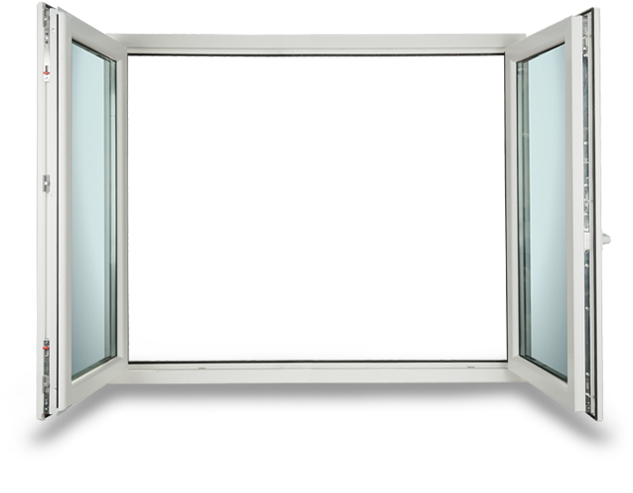
The Drunk Uncle Named vfork()
Problem: vfork()+exec() is not atomic!
//Suppose that the parent process is
//run as the privileged "root" user.
//Non-root users can't send signals
//to root processes.
pid_t pid = vfork();
if(pid == 0){
//In child (parent is suspended); drop
//privilege so child lacks root powers
setuid(nonroot_user);
A process owned by nonroot_user can send SIGSTOP to child; child is blocked, and so is the privileged parent—denial of service!
execve(nonroot_binary, NULL, NULL);
exit(1); //Kill child if execve()
//fails and we get here.
}

Slide 10
The Drunk Uncle Named vfork()
Problem: vfork()+exec() is not atomic!
Solution for priority inversion: Use fork()+exec().
[fork()+exec() still isn’t atomic, but the denial of service is now fixed since the parent isn’t blocked waiting for the child.]

Slide 11
Fun With Symlinks
Symbolic link: special file whose contents are name of another file
Ex: link –s /etc/shadow /tmp/foo
/tmp/foo is now an alias for /etc/shadow
When a process P wants to read/write/execute /tmp/foo, the kernel checks whether P has the appropriate access permissions for the underlying path /etc/shadow
A program can check whether path refers to symlink or regular file
Sounds pretty secure, right?
SO CLOSE
Without careful coding, a program’s security checks on a pathname are not atomic with respect to the dereferencing of pathname!

Slide 12
//Imagine that a mailserver runs with
//root privileges.
char *filename = "/home/loki/mailbox";
char *new_msg = get_new_msg_for(“loki");
if(new_msg == NULL){
return;
}
int new_msg_len = strlen(new_msg);
//Write the new message into Loki's
//mailbox, but we're paranoid! Only
//write the new message if Loki's
//mailbox path isn't a symlink.
struct stat lstat_info;
int fd;
lstat(filename, &lstat_info);
if(!S_ISLNK(lstat_info.st_mode)){
$ rm /home/loki/mailbox
$ ln –s /etc/shadow
/home/loki/mailbox
The password file will get overwritten with the contents of Loki’s new email! Note that LOKI CAN EMAIL HIMSELF.
//Window of vulnerability
fd = open(filename, O_RDWR);
write(fd, new_msg, new_msg_len);
close(fd);
}
Notes:
-IMPORTANT NOTE: lstat doesn’t follow symlinks! In other words, if the filename that is passed to lstat() is a symlink, then lstat() will give you information about the symlink, not the file that the symlink points to.
-The .st_mode field of a struct stat tells you whether the thing that you’re stat’ing is a file, a directory, a symlink, etc.
-Note that open() *does* follow symlinks. So, a call to open() will open whatever file is pointed to by the symlink.

Slide 13
char *filename = "/home/loki/mailbox";
char *new_msg = get_new_msg_for(“loki");
if(new_msg == NULL){return;}
int new_msg_len = strlen(new_msg);
struct stat lstat_info;
struct stat fstat_info;
int fd;
lstat(filename, &lstat_info); //Doesn’t follow
//symlinks
fd = open(filename, O_RDWR); //*Does* follow
//symlinks--“dereferences” symlink to get
//fd which represents the symlink target
fstat(fd, &fstat_info);
if (lstat_info.st_mode == fstat_info.st_mode &&
lstat_info.st_ino == fstat_info.st_ino &&
lstat_info.st_dev == fstat_info.st_dev){
write(fd, new_msg, new_msg_len);
}
close(fd);
Ensures that the filename used to open the file wasn’t a symlink!
//Attacker window to corrupt the fd that will
//be opened by the mailserver.
Notes:
-Remember that the .st_mode field of a struct stat tells you whether the thing that you’re stat’ing is a file, a directory, a symlink, etc.
-Why does this ensure that the filename wasn’t a symlink? Well, remember that open() DOES follow symlinks. So:
*if filename was a symlink and then was converted to a regular file in the race window, the two .st_modes will not match.
*similarly, if filename referred to a regular file and then was converted to a symlink in the race window, the two .st_inos won’t match: the first will be the inode for the regular file that file named first referenced, and the second will be the inode that the filename was changed to reference!
-if the file was remained a symlink throughout, the .st_modes will not match: the first will indicate a symlink, and the second will indicate a file.

Slide 14
Other Defenses
Linux added several new system calls to reduce the number of race conditions developers must check
//Ten directory race conditions
//to check.
int fd0 = open(“dirName/0.txt”);
int fd1 = open(“dirName/1.txt”);
. . .
int fd9 = open(“dirName/9.txt”);
//One directory race condition
//to check.
int dirFd = open(“dirName”);
int fd0 = openat(dirFd, “0.txt”);
int fd1 = openat(dirFd, “1.txt”);
. . .
int fd9 = openat(dirFd, “9.txt”);
Once process has an fd for a path, symlink shenanigans won’t change the inode that the file descriptor points to!

Slide 15
Other Defenses
There have been various research proposals to add transactional support to file systems
Regular journaling file systems provide all-or-nothing transactions for individual file system calls
We could add support for transactions which span multiple file system calls (e.g., see TxOS)
sys_xbegin();
struct stat st;
int fd;
lstat(filename, &st_info);
if(!S_ISLNK(st_info.st_mode)){
//Race window would ordinarily
//be here, but transactions
//are isolated from each other!
fd = open(filename, O_RDWR);
write(fd, buf, buf_len);
close(fd);
}
sys_xend();

Slide 16
Race Conditions: Non-atomic System Call Pairs
//Process X
sys_xbegin();
sys_call0();
sys_call1();
sys_xend();
//Process X
sys_call0();
sys_call1();
//Process Y
do_evil()
sys_call0();
sys_call0();
sys_call1();
sys_call1();
do_evil()
do_evil()
Time
Time
Txn
Txn
sys_call0();
sys_call1();
do_evil()
Impossible!
Time

Slide 17
Race Conditions At The Hardware Level

Slide 18
//Assume that memory //locations [x] and [y] //both initialized to 0
mov 1 --> [x]
mov [y] --> %eax
mov 1 --> [y]
mov [x] --> %ebx
x86 allows both threads to read 0 (which would be impossible if both threads run instructions sequentially (but may be interrupted)).
Store buffer
Store buffer
L1 i-cache
L1 d-cache
L1 i-cache
L1 d-cache
L2 cache
L2 cache
Per-core store buffer allows a core to write to memory and immediately continue execution as the write is asynchronously pushed through the memory hierarchy.
A core sees its own writes immediately, but may not be immediately aware of other cores’ writes.
L3 cache
RAM

Slide 19
How Hardware Shows Its Love For Us
Modern processors do unholy things to improve performance
Per-core store buffers avoid the need for a core to stall on a synchronous write through the memory hierarchy
A core may also reorder instructions (e.g., non-dependent loads and stores) to increase parallelism of hardware usage
Software needs a way to force sequential memory semantics when necessary (e.g., to implement locks), so hardware provides instructions which make it easier for software to reason about memory
Ex: Atomic instructions like compare-and-exchange, LL/SC
Ex: A memory barrier forces all instructions before the barrier to complete before any instruction after the barrier
//First core
while(shouldStop == 0){;}
//Load is dependent on the
//store, so hardware will
//*not* reorder the memory
//operations.
x = 42;
y = x;
//Second core
answer = 42;
printf("%d", answer);
shouldStop = 1;
mem_barrier();
mem_barrier();
This code may not print 42!
No data dependency w.r.t. the local core. So, hardware may reorder the stores!

Slide 20
Race Conditions Caused By Poor Locking Discipline

Slide 21
Race Condition in Linux’s ELF Loader
Just like OS161, Linux has code to load an ELF binary into memory, parse it, and initialize various in-memory regions for the stack, heap, and code
Each process structure has a struct mm_struct representing the process’ address space
Kernel must grab mm_struct::mmap_sem before modifying the process’ regions (there’s one struct vm_area_struct for each region)
struct mm_struct{
struct vm_area_struct *mmap; /* List of VMAs */
pgd_t *pgd; /* Page table directory pointer,
* i.e., the thing that gets
* assigned to %cr3 */
struct rw_semaphore mmap_sem; /* Protects VMAs */
//...etc...
};

Slide 22
//In Linux 2.4.28, the mmap_sem lock was released too early!
static int load_elf_library(struct file *file){
down_write(&current->mm->mmap_sem);
//Update the code VMA for the ELF library.
error = do_mmap(file,
ELF_PAGESTART(elf_phdata->p_vaddr),
(elf_phdata->p_filesz +
ELF_PAGEOFFSET(elf_phdata->p_vaddr)),
PROT_READ | PROT_WRITE | PROT_EXEC,
MAP_FIXED | MAP_PRIVATE | MAP_DENYWRITE,
(elf_phdata->p_offset -
ELF_PAGEOFFSET(elf_phdata->p_vaddr)));
up_write(&current->mm->mmap_sem);
if(error != ELF_PAGESTART(elf_phdata->p_vaddr))
goto out_free_ph;
elf_bss = elf_phdata->p_vaddr + elf_phdata->p_filesz;
padzero(elf_bss);
len = ELF_PAGESTART(elf_phdata->p_filesz + elf_phdata->p_vaddr +
ELF_MIN_ALIGN - 1);
bss = elf_phdata->p_memsz + elf_phdata->p_vaddr;
if(bss > len) //Create the data VMA for the ELF library.
do_brk(len, bss - len);
//do_brk() assumes mmap_sem is held!

Slide 23
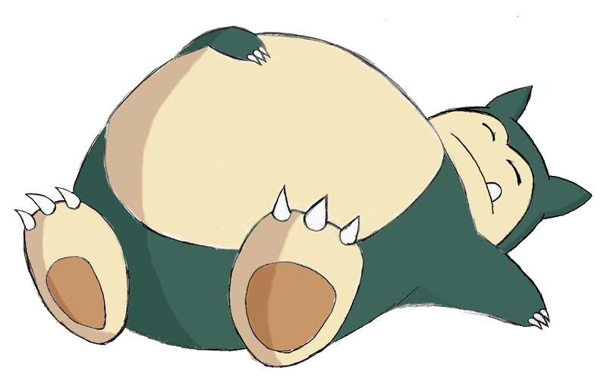
unsigned long do_brk(unsigned long addr, unsigned long len){
struct rb_node ** rb_link, * rb_parent;
find_vma_prepare(..., &rb_link, &rb_parent);
//Allocate a new VMA to represent the new
//extension to the process’ address space.
struct vm_area_struct *vma = kmem_cache_alloc(vm_area_cachep,
SLAB_KERNEL);
if(!vma)
return -ENOMEM;
//Update VMA bookkeeping.
vma->vm_mm = mm;
vma->vm_start = addr;
vma->vm_end = addr + len;
vma->vm_flags = flags;
vma->vm_page_prot = protection_map[flags & 0x0f];
//Other bookkeeping values updated . . .
//Add the new VMA to the process’ set of VMAs
//(the VMAs are stored in a red-black tree).
vma_link(mm, vma, prev, rb_link, rb_parent);
return addr;
}
The kernel may sleep during memory alloc!
Attacker launches a program with several threads that allocate a lot of memory and load carefully-crafted ELF binaries as dynamic libraries. Goal: Trigger a race condition that corrupts memory in attacker-controlled way!

Slide 24
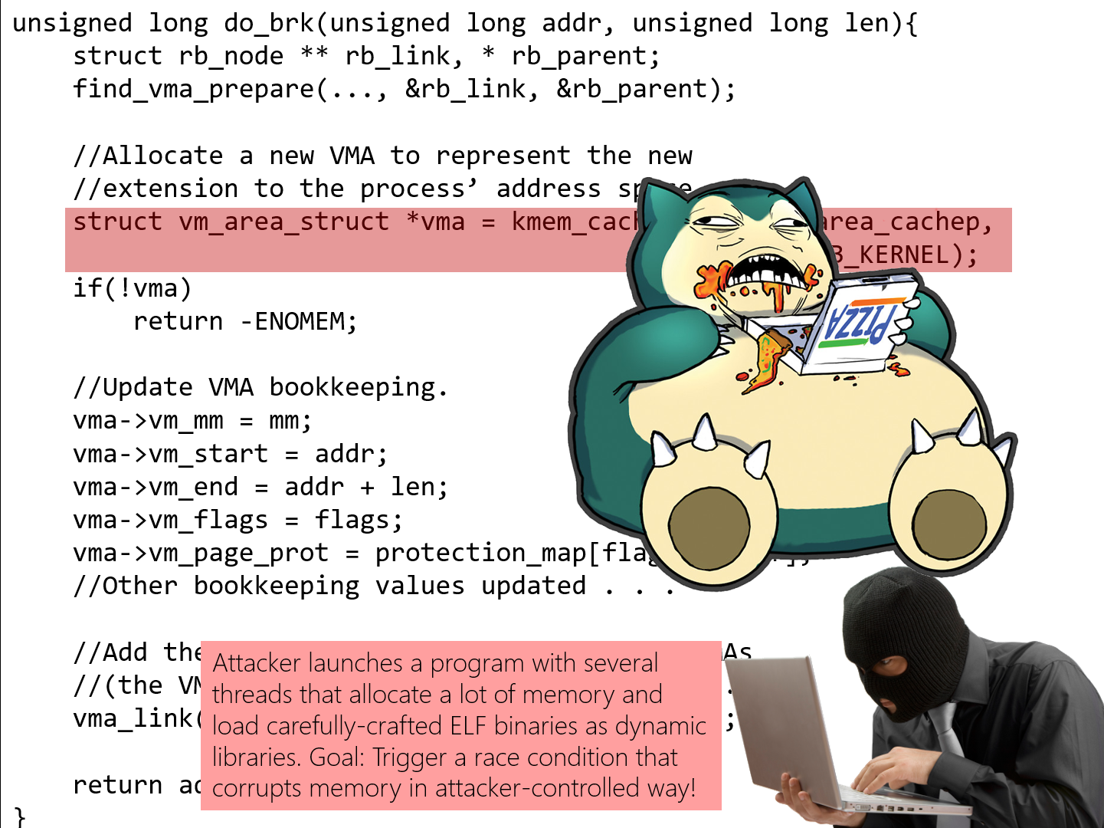
vma_link(mm, vma, prev, rb_link, rb_parent);
vma_link(mm, vma, prev, rb_link, rb_parent);

Slide 25
vma_link(mm, vma, prev, rb_link, rb_parent);
rb_link and rb_parent are pointers which vma_link() uses to write kernel memory
Those pointers are supposed to be updated atomically, one thread at a time
However, since a thread can go to sleep without holding a lock, the attacker can try to unleash a race condition which corrupts the pointers with attacker-controlled values!
Later, when the sleeping thread awakes, it will write memory through corrupted pointers, to addresses of the attacker’s choosing
If the attacker supplies the data for the write, the attacker also chooses the new contents of those memory addresses
Ex: Overwriting a kernel function pointer to trick the kernel into invoking the wrong function
Virtual mem
Kernel struct
[funcPtr]
[otherStuff]
Corrupted pointer
Kernel function
foo()
Kernel function
bar()

Slide 26
//Also, in do_brk() . . .
/*
* mm->mmap_sem is required to
* protect against another thread
* changing the mappings while we
* sleep (on kmalloc for one).
*/
verify_mmap_write_lock_held(mm);
HOW DO WE PREVENT THIS?
In the case of this specific ELF vulnerability, the fix is to hold mmap_sem while the data region for the library is created
However, memory corruption vulnerabilities are often tricky to prevent; they represent a large fraction of all security holes!

