Slide 1
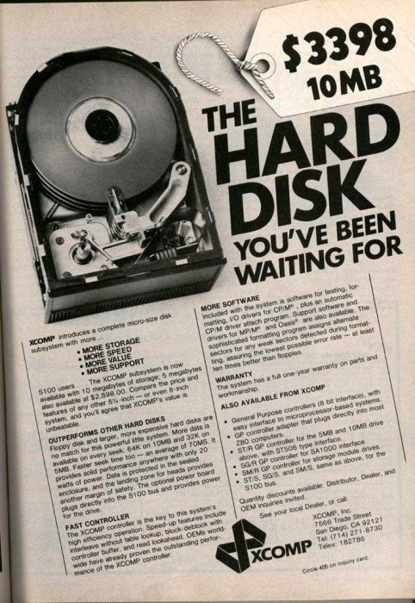
Storage
Devices
CS 161: Lecture 11
3/21/17

Slide 2
R/W heads
Spindle
Platter
Notes:
Note that the platters are double-sided, i.e., they store data on both sides. Also note that all of the read/write heads move together, in unison.

Slide 3
Track
Cylinder
Sector
Cylinder
group
Notes:
For a long time, hard disks used a sector size of 512. However, modern disks now use a sector size of 4K.

Slide 4
Accessing Data On A Hard Disk
Access time is governed by several mechanical latencies
Seek time: Moving the disk head to the right track
Laptop/desktop drives have average seek times of 8—15ms
High-end server drives have average seek times of 4ms
Rotational latency: Moving the target sector under the disk head
Dependent on the revolutions-per-minute (RPM) of the drive
RPMs between 5400—7200 typical for laptop and desktop drives; server drives can go up to 15,000
So, average rotational latencies are 5.56—4.17 ms for laptop/desktop drives, 2 ms for high-end server drive
If you want to read or write an entire cylinder group, you just have to pay the seek cost, and then you can read/write the cylinder group as the disk rotates

Slide 5
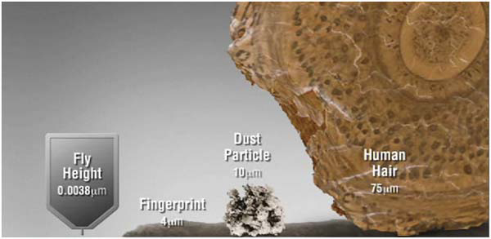
Your Hard Disk Is Sealed To Prevent Disk Head Tragedies
[Courtesy of our friends at Seagate]

Slide 6
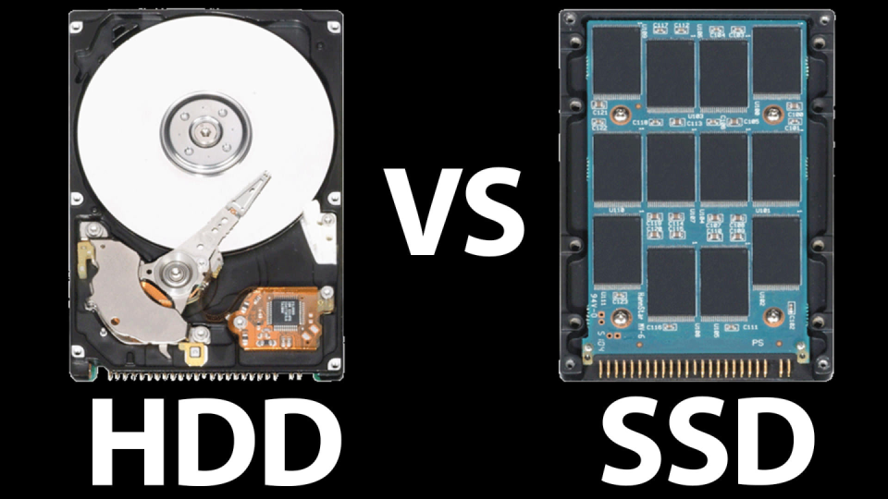

Slide 7
Solid-state Storage Devices (SSDs)
Unlike hard drives, SSDs have no mechanical parts
SSDs use transistors (just like DRAM), but SSD data persists when the power goes out
NAND-based flash is the most popular technology, so we’ll focus on it
High-level takeaways
SSDs have a higher $/bit than hard drives, but better performance (no mechanical delays!)
SSDs handle writes in a strange way; this has implications for file system design

Slide 8
Solid-state Storage Devices (SSDs)
An SSD contains blocks made of pages
A page is a few KB in size (e.g., 4 KB)
A block contains several pages, is usually 128 KB or 256 KB
. . .
Page
0
1
2
3
4
5
6
7
8
9
10
11
Block
0
1
2
To write a single page, YOU MUST ERASE THE ENTIRE BLOCK FIRST
A block is likely to fail after a certain number of erases (~1000 for slowest-but-highest-density flash, ~100,000 for fastest-but-lowest-density flash)

Slide 9
SSD Operations (Latency)
Read a page: Retrieve contents of entire page (e.g., 4 KB)
Cost is 25—75 microseconds
Cost is independent of page number, prior request offsets
Erase a block: Resets each page in the block to all 1s
Cost is 1.5—4.5 milliseconds
Much more expensive than reading!
Allows each page to be written
Program (i.e., write) a page: Change selected 1s to 0s
Cost is 200—1400 microseconds
Faster than erasing a block, but slower than reading a page
Hard disk: 4—15ms avg. seek latency
2—6ms avg. rotational latency

Slide 10
Block
Page
10011110
00100010
01101101
11010011
To write the first page, we must first erase the entire block
11111111
11111111
11111111
11111111
Now we can write the first page . . .
. . . but what if we needed the data in the other three pages?
00110011
11111111
11111111
11111111

Slide 11
Flash Translation Layer (FTL)
Goal 1: Translate reads/writes to logical blocks into reads/erases/programs on physical pages+blocks
Allows SSDs to export the simple “block interface” that hard disks have traditionally exported
Hides write-induced copying and garbage collection from applications
Goal 2: Reduce write amplification (i.e., the amount of extra copying needed to deal with block-level erases)
Goal 3: Implement wear leveling (i.e., distribute writes equally to all blocks, to avoid fast failures of a “hot” block)
FTL is typically implemented in hardware in the SSD, but is implemented in software for some SSDs

Slide 12
FTL Approach #1: Direct Mapping
Have a 1-1 correspondence between logical pages and physical pages
Logical
pages
Physical
pages
Reading a page is straightforward
Writing a page is trickier:
Read the entire physical block into memory
Update the relevant page in the in-memory block
Erase the entire physical block
Program the entire physical block using the new block value

Slide 13
Sadness #1: Write amplification
Writing a single page requires reading and writing an entire block
Sadness #2: Poor reliability
If the same logical block is repeatedly written, its physical block will quickly fail
Particularly unfortunate for logical metadata blocks

Slide 14
FTL Approach #2: Log-based mapping
Basic idea: Treat the physical blocks like a log
Send data in each page-to-write to the end of the log
Maintain a mapping between logical pages and the corresponding physical pages in the SSD
Logical
pages
0
1
2
3
4
5
6
7
8
9
10
11
. . .
Page
0
1
2
3
4
5
6
7
8
9
10
11
Block
0
1
2

Slide 15
Logical-to-physical map
Log head
Uninitialized
. . .
Valid
Page
0
1
2
3
4
5
6
7
8
9
10
11
Block
0
1
2

Slide 16
write(page=92, data=w0)
Logical-to-physical map
92 --> 0
erase(block0)
program(page0, w0)
logHead++
Log head
Log head
Uninitialized
w0
. . .
1*
1*
1*
1*
Valid
Page
0
1
2
3
4
5
6
7
8
9
10
11
Block
0
1
2

Slide 17
write(page=92, data=w0)
Logical-to-physical map
92 --> 0
17 --> 1
erase(block0)
program(page0, w0)
logHead++
write(page=17, data=w1)
program(page1, w1)
logHead++
Log head
Log head
Uninitialized
w0
w1
1*
1*
. . .
1*
Valid
Page
0
1
2
3
4
5
6
7
8
9
10
11
Block
0
1
2

Slide 18
write(page=92, data=w0)
Logical-to-physical map
92 --> 0
17 --> 1
erase(block0)
program(page0, w0)
logHead++
write(page=17, data=w1)
Advantages w.r.t. direct mapping
Avoids expensive read-modify-write behavior
Better wear levelling: writes get spread across pages, even if there is spatial locality in writes at logical level
program(page1, w1)
logHead++
Log head
Uninitialized
w0
w1
1*
1*
. . .
Valid
Page
0
1
2
3
4
5
6
7
8
9
10
11
Block
0
1
2

Slide 19
write(page=92, data=w4)
Logical-to-physical map
92 --> 0
17 --> 1
33 --> 2
68 --> 3
erase(block1)
92 --> 4
program(page4, w4)
logHead++
Garbage version of logical block 92!
Log head
Log head
Uninitialized
w0
w1
w4
. . .
w2
w3
1*
1*
1*
1*
Valid
Page
0
1
2
3
4
5
6
7
8
9
10
11
Block
0
1
2

Slide 20
At some point, FTL must:
Logical-to-physical map
92 --> 0
17 --> 1
33 --> 2
68 --> 3
Read all pages in physical block 0
92 --> 4
Write out the second, third, and fourth pages to the end of the log
Update logical-to-physical map
Garbage version of logical block 92!
Log head
Uninitialized
w0
w1
w2
w3
w4
1*
1*
1*
. . .
Valid
Page
0
1
2
3
4
5
6
7
8
9
10
11
Block
0
1
2

Slide 21
Trash Day Is The Worst Day
Garbage collection requires extra read+write traffic
Overprovisioning makes GC less painful
SSD exposes a logical page space that is smaller than the physical page space
By keeping extra, “hidden” pages around, the SSD tries to defer GC to a background task (thus removing GC from critical path of a write)
SSD will occasionally shuffle live (i.e., non-garbage) blocks that never get overwritten
Enforces wear levelling
Notes:
The garbage collection traffic is “extra” because it doesn’t correspond to an IO that was directly issued by an application---instead, the garbage collection traffic is pure bookkeeping overhead.

Slide 22
SSDs versus Hard Drives (Throughput)
Random
Sequential
Reads
Writes
Reads
Writes
Device
(MB/s)
(MB/s)
(MB/s)
(MB/s)
Samsung 840 Pro SSD
103 287 421 384
Seagate 600 SSD
84 252 424 374
Intel 335 SSD
39 222 344 354
Seagate Savio 15K.3 HD
2 2 223 223
Dollars per storage bit: Hard drives are 10x cheaper!
Source: “Flash-based SSDs” chapter of “Operating Systems: Three Easy Pieces” by the Arpaci-Dusseaus.
Notes:
There are three interesting trends to note:
1) Hard drives have terrible performance for random reads and writes. The reason is that, for random workloads, the disk head is moving all around, incurring a bunch of seek latencies and rotational delays. In contrast, an SSD only has to pay electronic latencies. But, as we see from this chart, a file system for SSDs would also benefit from converting random IOs to sequential ones, because SSDs also have a performance disparity between random and sequential IO.
2) A second interesting trend is that, for SSDs, random writes are faster than random reads. This is because the SSD can batch a bunch of writes, and then write them in one burst to the end of the log. The SSD can’t play those kinds of tricks with reads.
3) We see another interesting trend by looking at the sequential numbers. For sequential reads and writes, the performance difference between SSDs and hard drives is much smaller. So, if you’re designing a machine, and you know that the machine will only be running applications with sequential workloads, then maybe you should put a hard disk in the machine instead of an SSD. You’ll get a lot more storage capacity for the same amount of dollars, and your sequential performance will be pretty reasonable. In terms of dollar per storage bit, there’s a 10x differences between hard drives and SSDs. In other words, for a given amount of money, you can buy a hard disk that has ten times more storage than an SSD with the same dollar cost. So, SSDs have roughly twice as fast sequential throughput, but roughly a tenth of the storage capacity of a hard disk.

